Slide 1
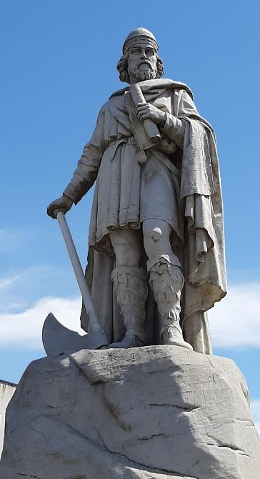
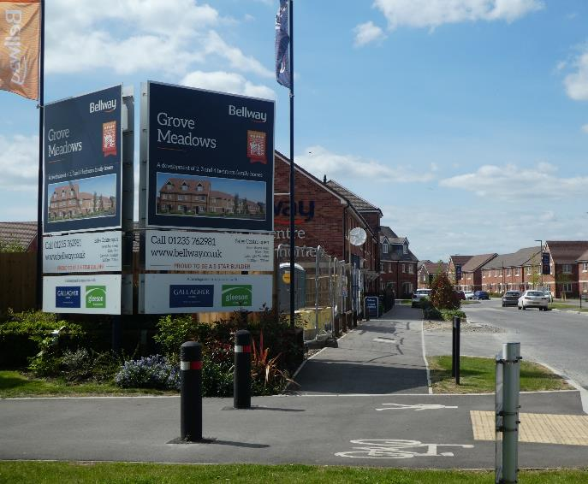
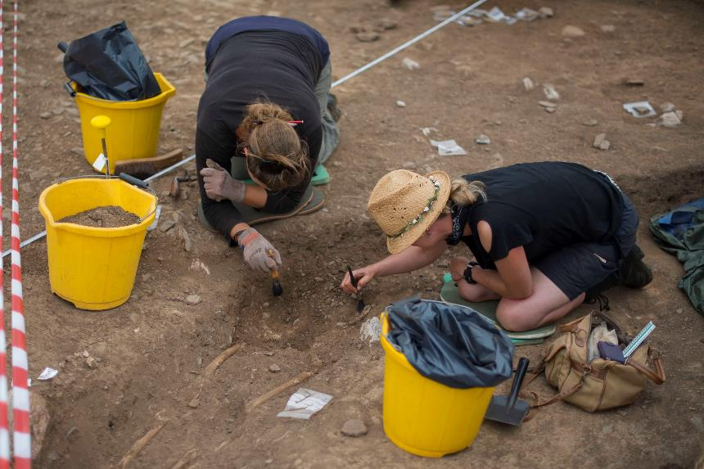
WHAT CAN DEVELOPMENT LED ARCHAEOLOGY TELL US ABOUT THE HISTORY OF SETTLEMENT IN THE WANTAGE AREA?
Paul Sayers

Slide 2
WHAT IS DEVELOPMENT LED ARCHAEOLOGY?
Carried out ahead of development
Part of planning process
Done by commercial archaeology companies
Overseen by County Archaeologist
Now forms the majority of excavations
Growth of commercial archaeology units e.g. Oxford Archaeology, Wessex Archaeology Thames Valley Archaeological Services
Developer pays
BUT
Lack of synthesis

Slide 3
TIME LINE
Early Modern 1540 1700
Medieval 1066 1540
Early Medieval 410AD 1066
Roman 43AD 410AD
Iron Age 800BC 43AD
Bronze Age 2,600 BC 700BC
Neolithic 4,000BC 2,200BC
Mesolithic 10,000BC 4,000BC
Palaeolithic 500,000BC 10,000BC

Slide 4
LAST TIME (2018 AGM)
South of Causeway:
Neolithic pottery and field boundaries
South of Summertown:
Roman settlement of modest status + burials
Monks Farm (south of Bellingers)
Bronze Age settlement

Slide 5
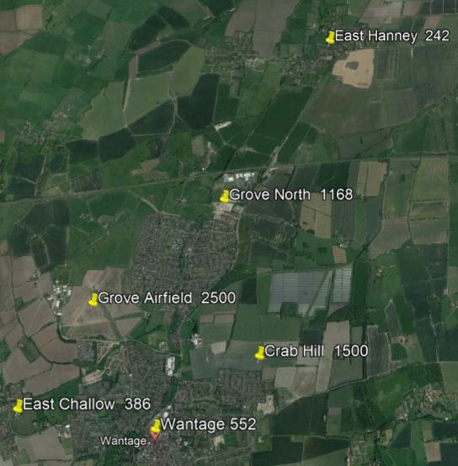
SITE LOCATIONS
2011 Census
Wantage 11,300
Grove 7,200
East Hanney 750
West Hanney 490
East Challow 770
------
Total 20,150 people
Planned development 6,900 dwellings
New population (say x3) 20,700 people

Slide 6
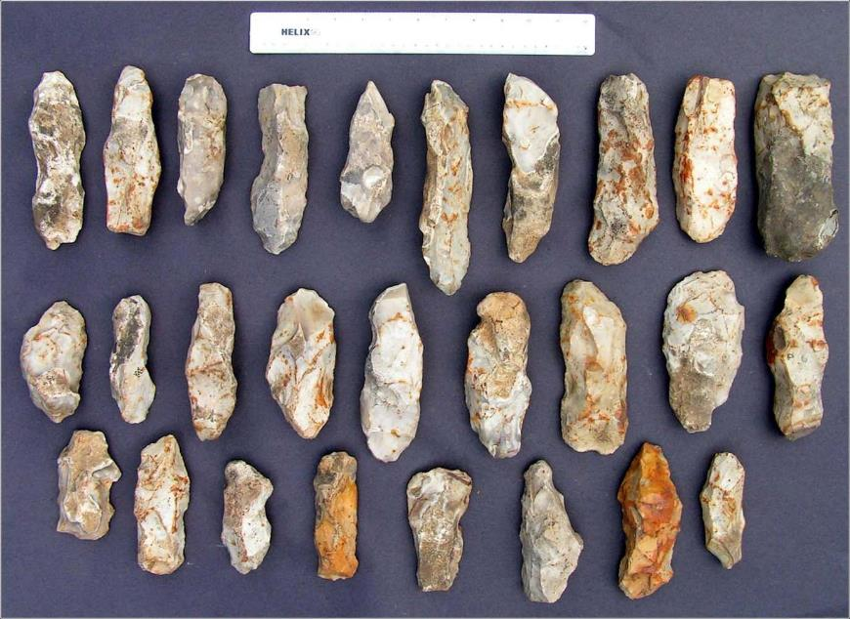
Mesolithic
Mesolithic flints from several
sites but these were
microliths–easily missed.
Knapping site at Monks farm

Slide 7
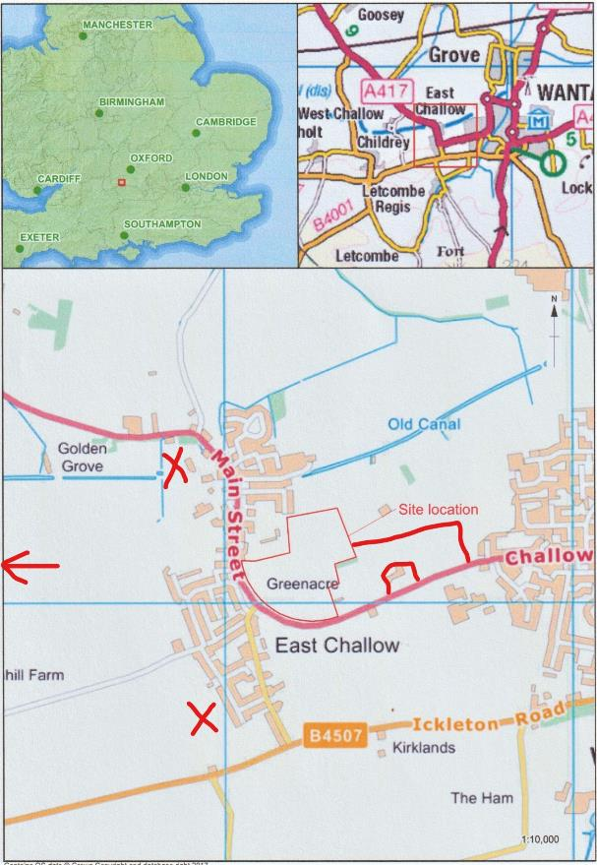
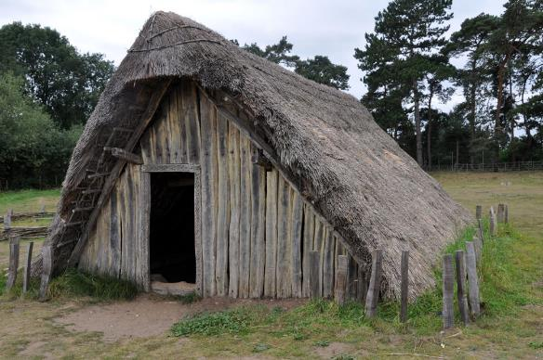
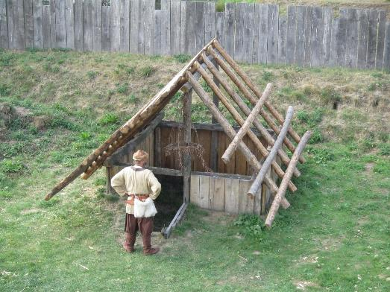
EAST CHALLOW (4 sites)
Little Roman despite nearby villa site
Romano-British settlement
Saxon sunken featured building (Grubenhaus)

Slide 8
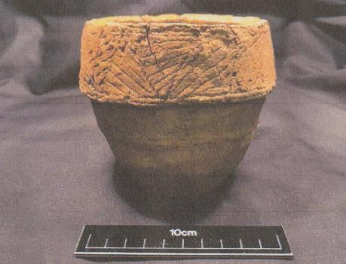
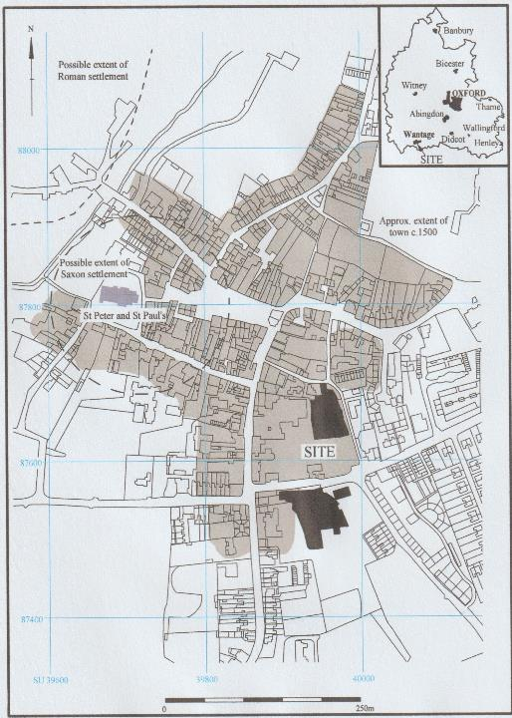
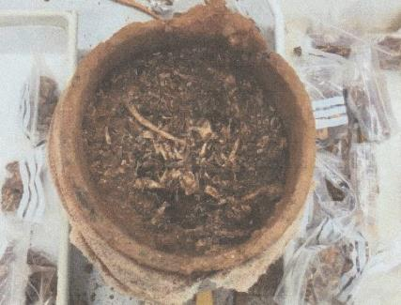
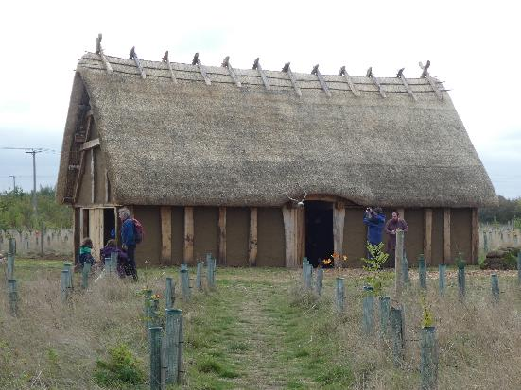
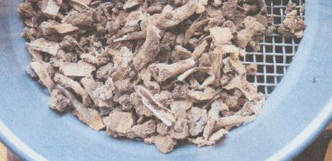
WANTAGE TOWN
S
St Mary’s School
Bronze Age: cremation cemetery
Saxon: postholes, pits, ditches, crouched burial, large timber building
Medieval: burgage plot boundaries

Slide 9
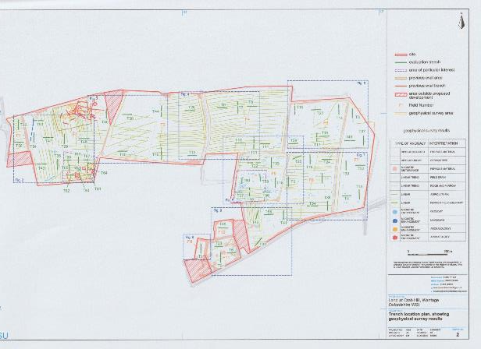
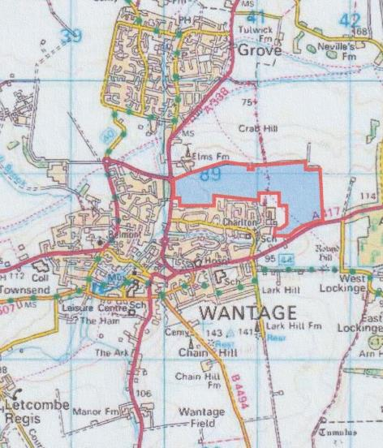
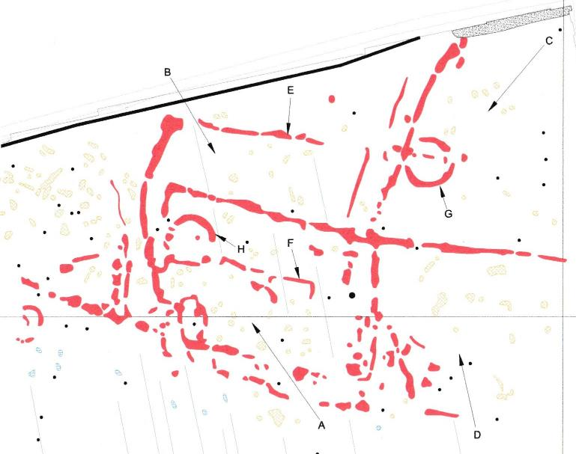
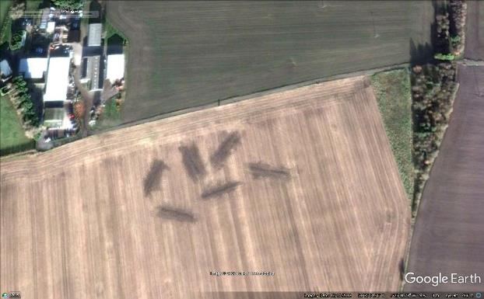
WANTAGE: CRAB HILL

Slide 10
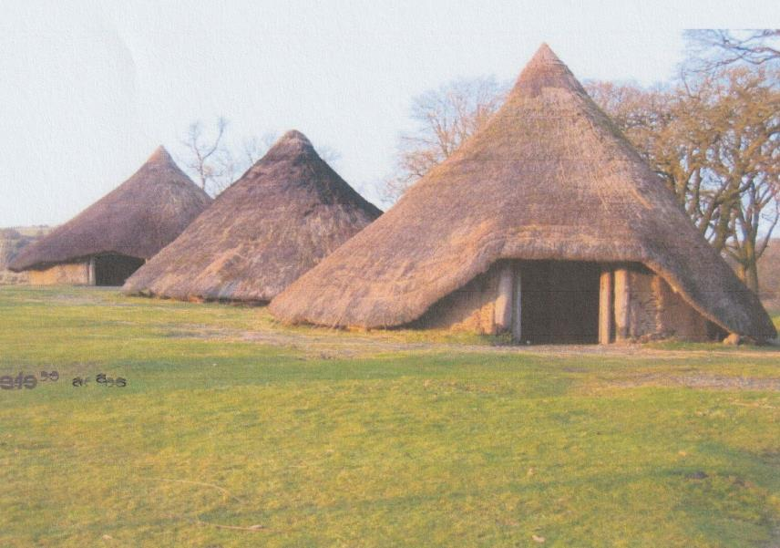
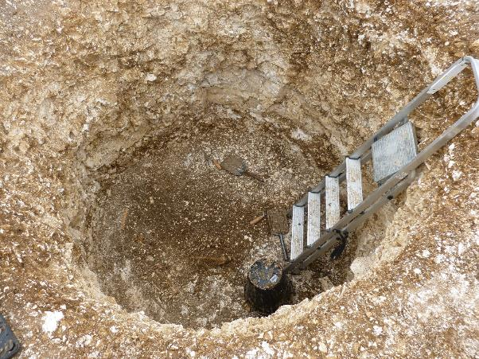
WANTAGE: CRAB HILL
Roundhouses: Castell Henllys
Grain storage pit: Winterbourne Kingston
Large Saxon boundary ditch and bank intended to be visible

Slide 11
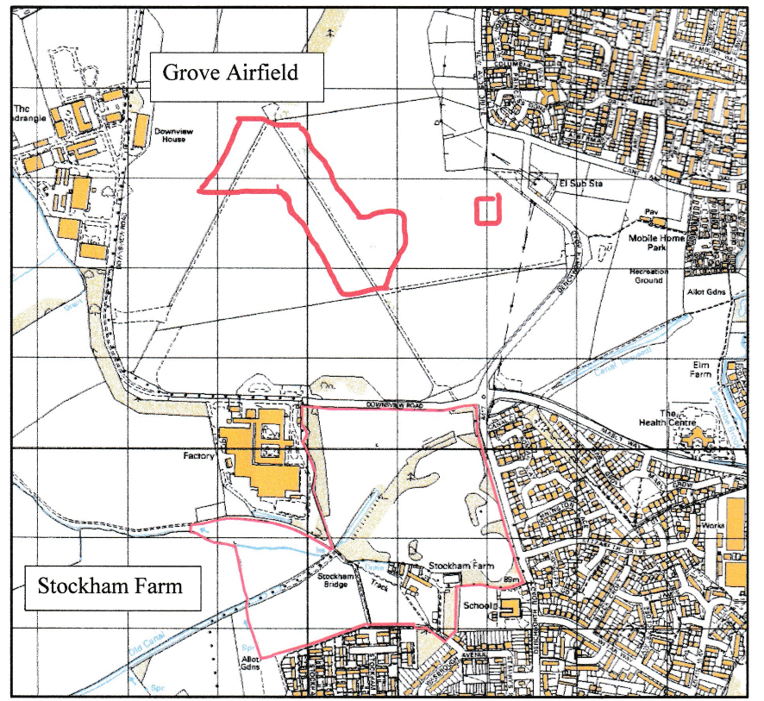
GROVE AIRFIELD and STOCKHAM FARM
Grove Airfield:
intense activity in Iron Age continuing into Roman period
Roman brick and roof tile from low status settlement
Stockham Farm:
Evidence of Bronze Age, Iron Age and Romano-British settlement but much disrupted by Medieval ploughing and spoil from airfield

Slide 12
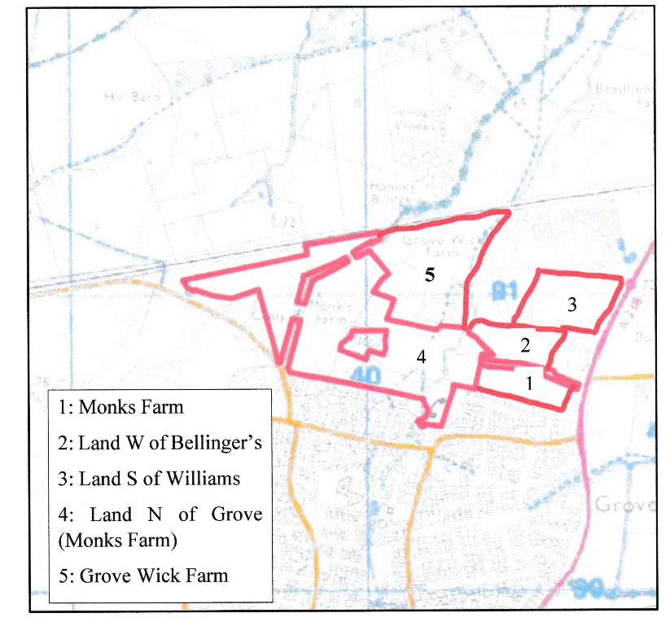
GROVE NORTH
5 sites on 50ha, 4 contractors
Bronze Age settlement, field systems and cremation burials
Iron Age settlement, including roundhouses and storage pits, field systems
Roman wall base, building materials, 1 cremation and 1 inhumation burial, field systems

Slide 13
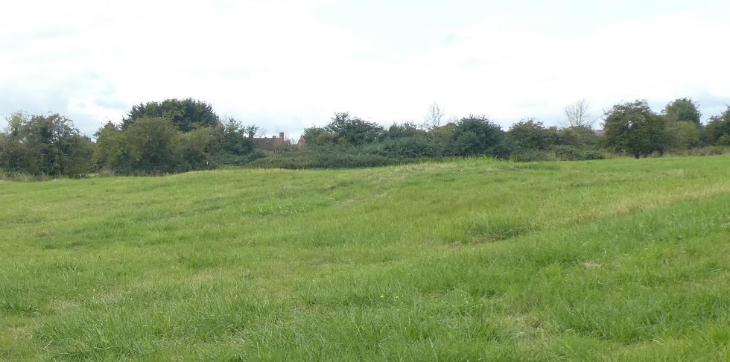
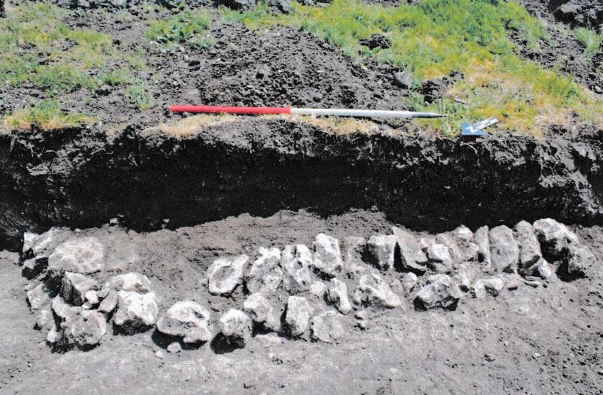
Settlement on Monks Farm was on slightly higher ground, above the Letcombe Brook,
Iron Age into Roman
(cf. ‘Island Villages’ !)
Base of Roman Wall, roof and flue tiles also found

Slide 14
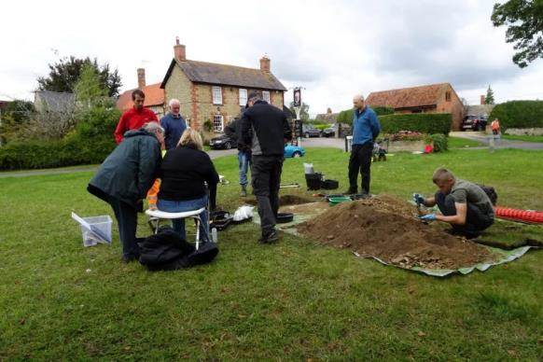
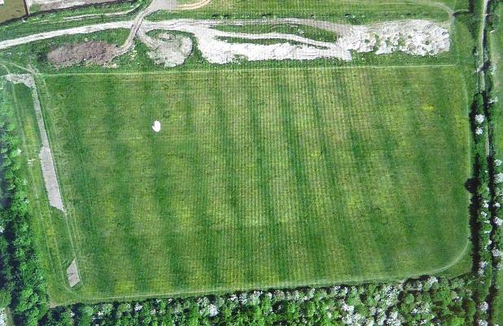
Why so little evidence of Saxon and Medieval settlement?
Saxon: documentary and place name evidence
under later settlement
Stanford test pits
Test pit Stanford
Medieval: ridge and furrow protects earlier, deeper features but trashes less deep
mostly under later settlement
deserted villages- Tulwick, Southcote (Circourt), North Denchworth
or shrunken- Goosey, East Hanney
Ridge and furrow in Church Farm Meadow

Slide 15
SYNTHESIS
Mesolithic flints from several sites, probably many others missed
Neolithic one pit deposit with pieces from 2 pots (EH),
flints elsewhere
Bronze Age, settlement, cremation burials, BA worked flint,
field systems
Iron Age settlement, some in prominent locations, field systems
Romano- British low status settlement, continuity from IA, field systems
Anglo-Saxon Wantage, E Challow sfb, Crab Hill boundary ditch
Medieval mainly ridge and furrow

