Slide 1
Hanney History Walk 2020
Hanney History Group
invites you to take a
“figure of eight” walk through
West and East Hanney,
with old photographs and notes on some of the buildings you will see on your way.
Not every historic building is included, and even some of the notes could be wrong – but enjoy!
Origin of the walk
As a consequence of the world-wide pandemic of the Corona Virus Disease Covid19, in March 2020 the people of the United Kingdom were confined to their homes, except for defined reasons such as essential shopping, medical needs and limited exercise within or from home.
As a result, many people walked around the villages for exercise.
In response, a small group of Hanney History Group members promptly produced and published a pamphlet to provide a historical perspective of the villages. The original is available on this website.
This presentation is derived from the pamphlet. The text has been slightly changed to accommodate some corrections and comments.

Slide 2
The route
The map is from the first Ordnance Survey 1 inch map, dated 1830.
So, starting at the Hanney War Memorial Hall, we walk along the Causeway to West Hanney Green.

Slide 3
the Butter Cross
Our first picture of West Hanney is looking across the Green, in the centre of which is the Buttercross.
But if you had been here in the late 19th century you wouldn’t have seen it, as it had been demolished, and the stones distributed around West Hanney!

Slide 4
It wasn’t until the early 20th century, when, organised by Mr Emmott Large, of Pound Croft in East Hanney, the stones were recovered and the cross rebuilt.
The picture shows the dedication ceremony in March 1908, led by the Bishop of Oxford.
The Olde Forge can be seen in the background – we’ll visit this site on our way back.

Slide 5
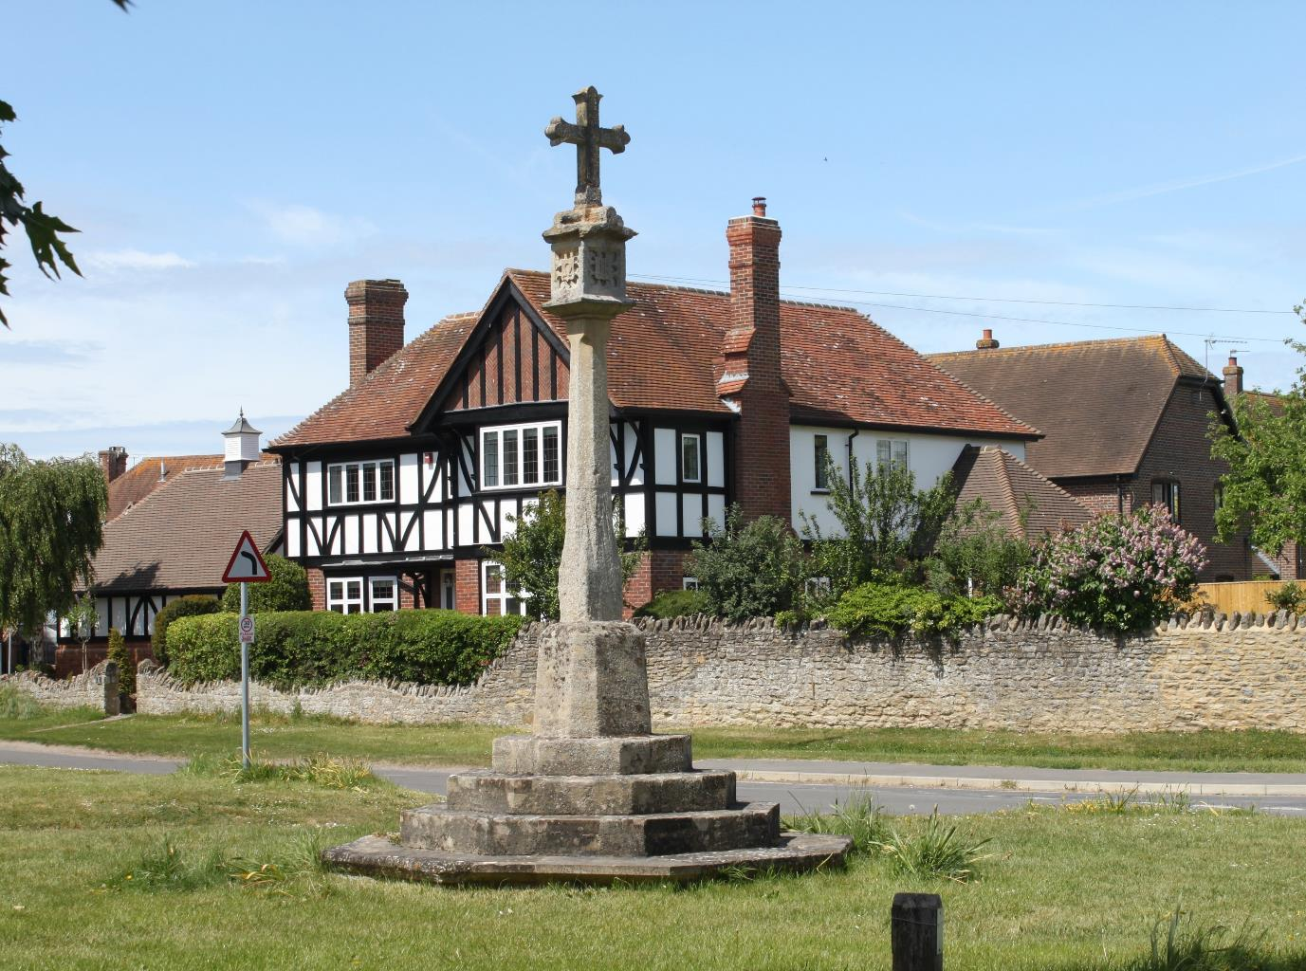

Slide 6
the “Way to the Church between Raised Causeways”
Looking up, we see the
“Way to the Church between Raised Causeways”
as described in the January 1943 edition of Country Life – (price One Shilling and Six Pence – 1/6… £0.075!).

Slide 7
But keen observers will see that this view of the church shows the original castellated tower.
This fell into disrepair, and the top 6ft was demolished (or it collapsed, according to some versions) in the late 1930s. Many of the stones are still visible in some West Hanney gardens.

Slide 8
The church contains many treasures, including medieval brasses.
But maybe most intriguing is the memorial plaque to
Elizabeth Bowles, who died in 1718, aged 124 years…(??).
This fine church is well worth a separate visit.

Slide 9
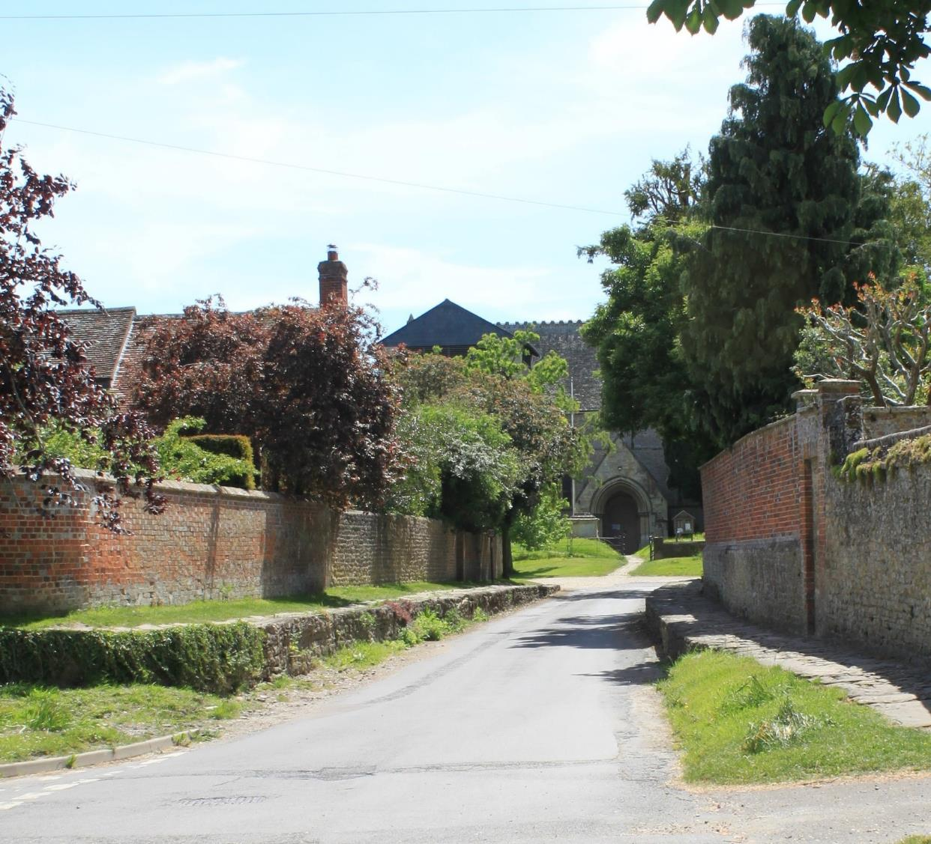

Slide 10
Looking back to the Green we can see the same raised causeways, but there is a key absence in this view – the Buttercross.
It’s up to you to work out whether you could have seen it, anyway, or whether it is missing?
The age of what appears to be an open car in front of The Old Forge would give a clue – what do you think?

Slide 11
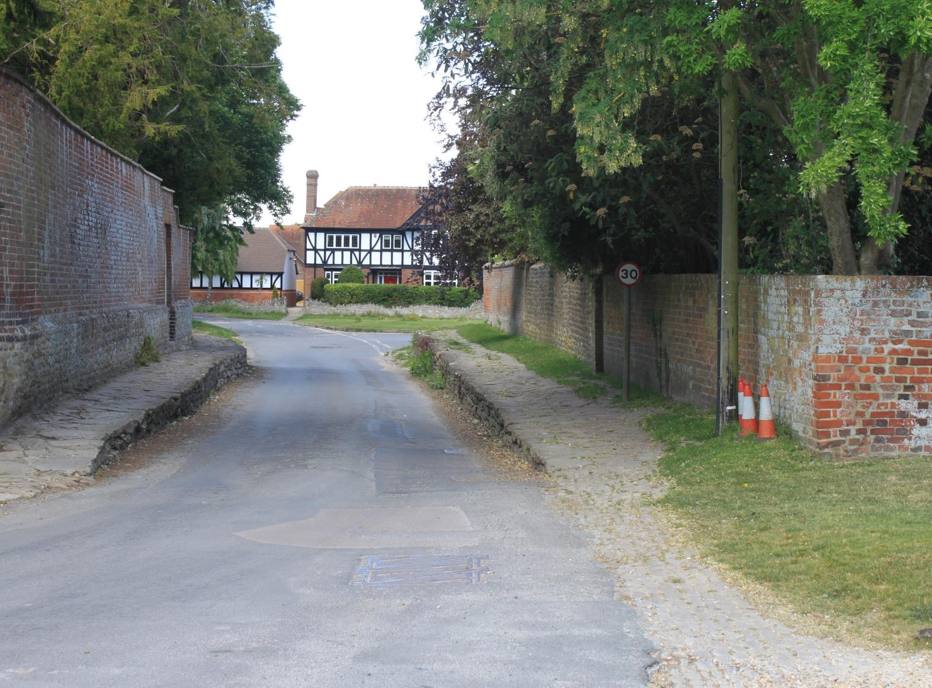

Slide 12
Dower House
Looking to your left as you approach the Church you see what is now called Dower House – a historically interesting name, as it was originally the “Yate Dower House”.
This was named after the Yate family of Lyford, who, amongst other things, established charities which remain active parts of the Hanney Parochial Charities today.

Slide 13
Dower House
The photograph shows the time when it was West Hanney Post Office – for reasons shrouded in the mists of time.
It was still the Post Office at the time of the1943 Country Life article, but became a private house again in the 1960s.

Slide 14
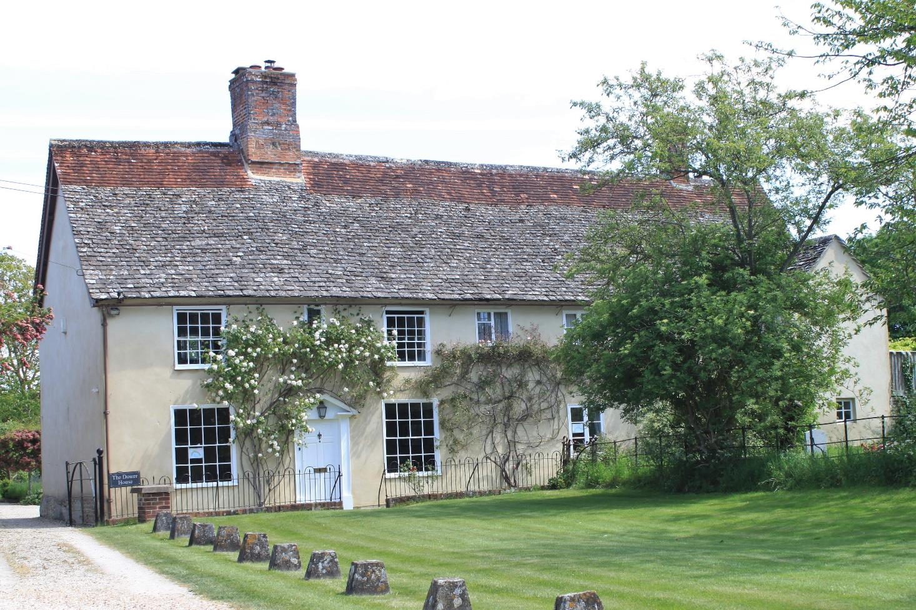

Slide 15
West Hanney House
Turning right into Church Street it’s difficult not to be impressed by the imposing
West Hanney House, previously known as the Old Rectory.
It was built between 1720 and 1730 on the site of a Tudor building, which had a Tudor fireplace, and a chamber for smoking sides of bacon.

Slide 16
West Hanney House
According to the Country Life article
“the use of the scarlet rubbed bricks contrasts with the grey flared headers and architraves to produce the most singular and picturesque silhouette”.
But in order to create this look of symmetry, if you look carefully you can see that quite a number of the windows are in fact false.
Whether that was done on purpose, or was a result of using inexperienced builders let free after the building of Blenheim Palace, is an interesting question.

Slide 17
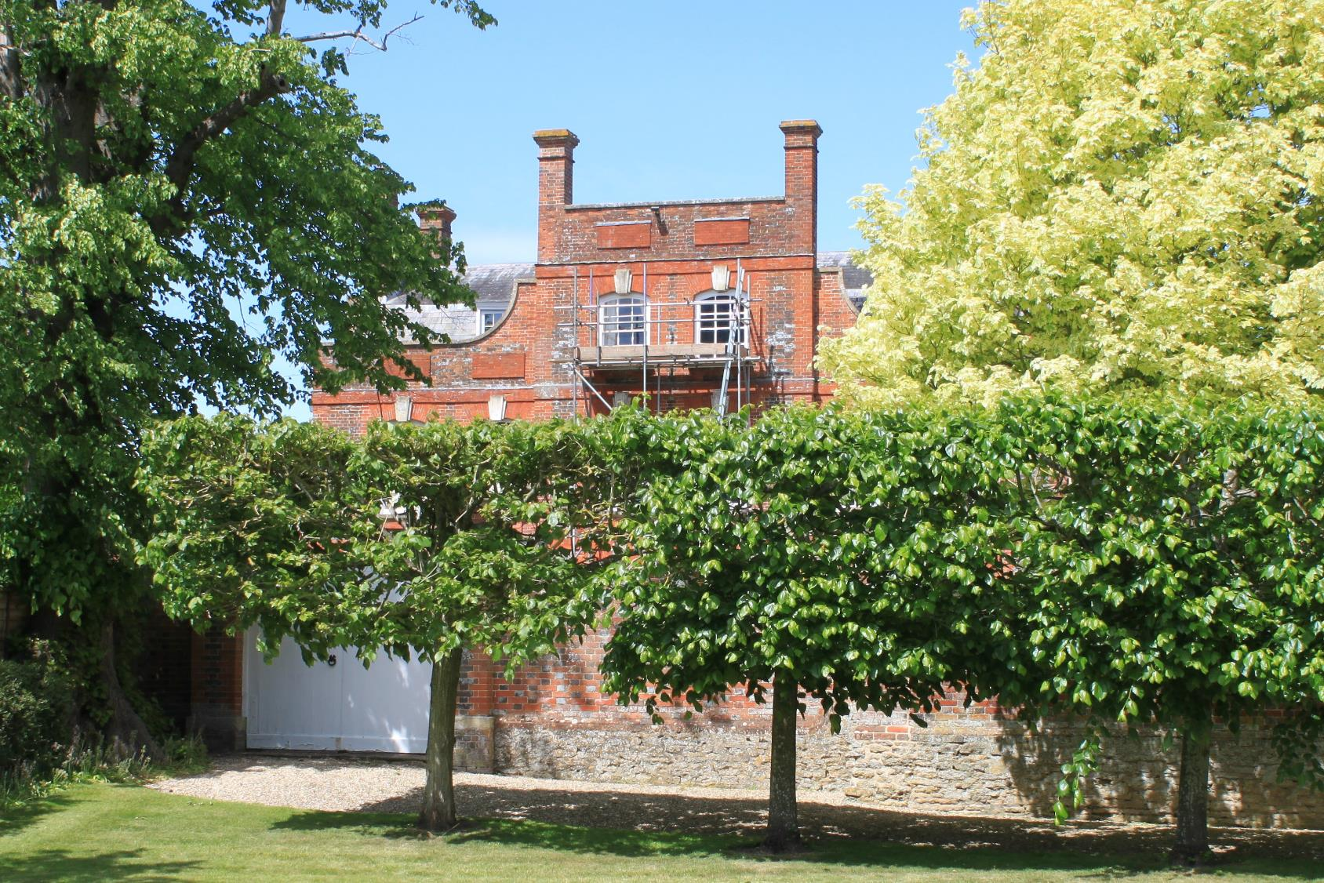

Slide 18
The Plough
The Plough has been a pub in West Hanney since the 1890s, before which the building is thought to have been a wheelwright’s workshop.
This picture shows it looking much the same as it does now, but the cottage in front was demolished in the 1960s.
The owners of The Plough wanted to sell it for housing development in 2015, but Hanney residents clubbed together to buy it as a “Community Pub”, and every resident in the village now has the option of a shareholding.

Slide 19
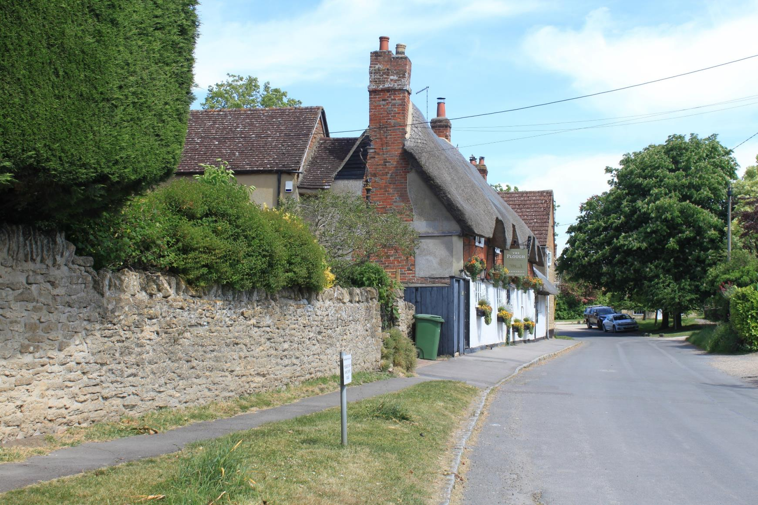

Slide 20
Deans Farm
As you pass Deans Farm on the left you may notice several wooden buildings in the grounds. These were used for many years as accommodation for regular Conventions of a Christian group, sometimes known as the Nazarenes.
The picture shows cars parked outside for one gathering, maybe from the 1930 - 1940s.
These Conventions took place in West Hanney from 1915 to 2012, when they moved to another location near Lydney in the Forest of Dean.

Slide 21
Heading’s Pond
Before reaching Main Street you pass the site of “Heading’s Pond” on the left – now drained, and with a bench for you to have a quick rest on.
Records show William and Georgina Heading having children in West Hanney in 1853-55. Things must have gone well, since William Williams Heading had children in Hanney between 1873-81, and is listed as a “Gentleman” Farmer.
Looking back, you see over the pond what is now called Rose Cottage, but was probably not called this at the time of the photograph.

Slide 22
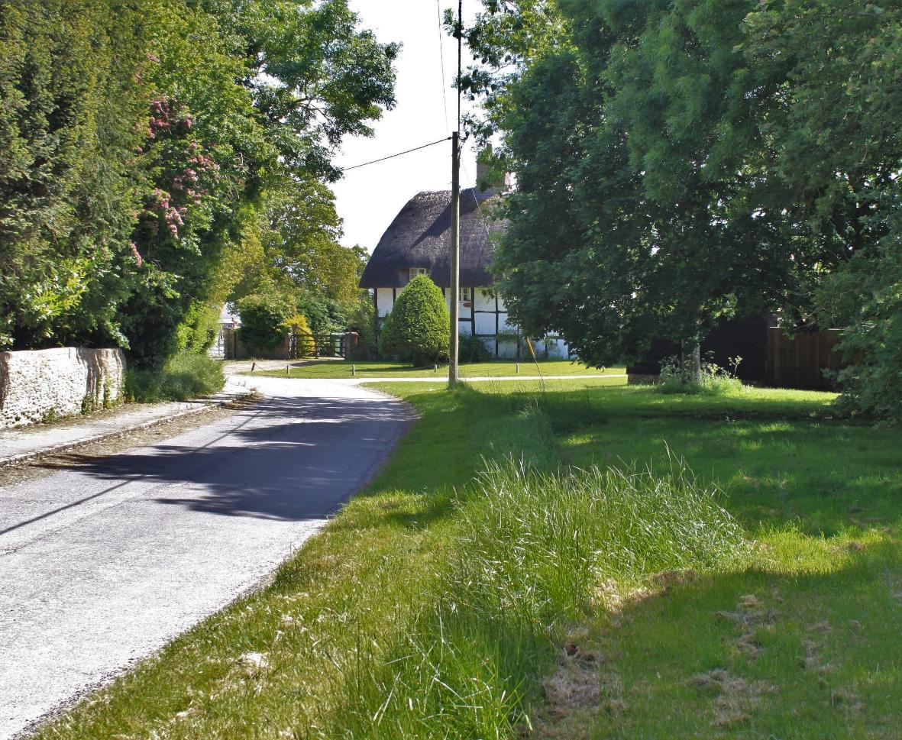

Slide 23
Main Street
Turning right along Main Street you will not see much similarity between how it looks today and at the time of this picture – say somewhere in the 1920s.
On the left is a thatched cottage called Moss Edge, the same name as the modern house on this site.
But the photograph shows only one or two other houses – a far cry from today – though the cables remain the same!

Slide 24
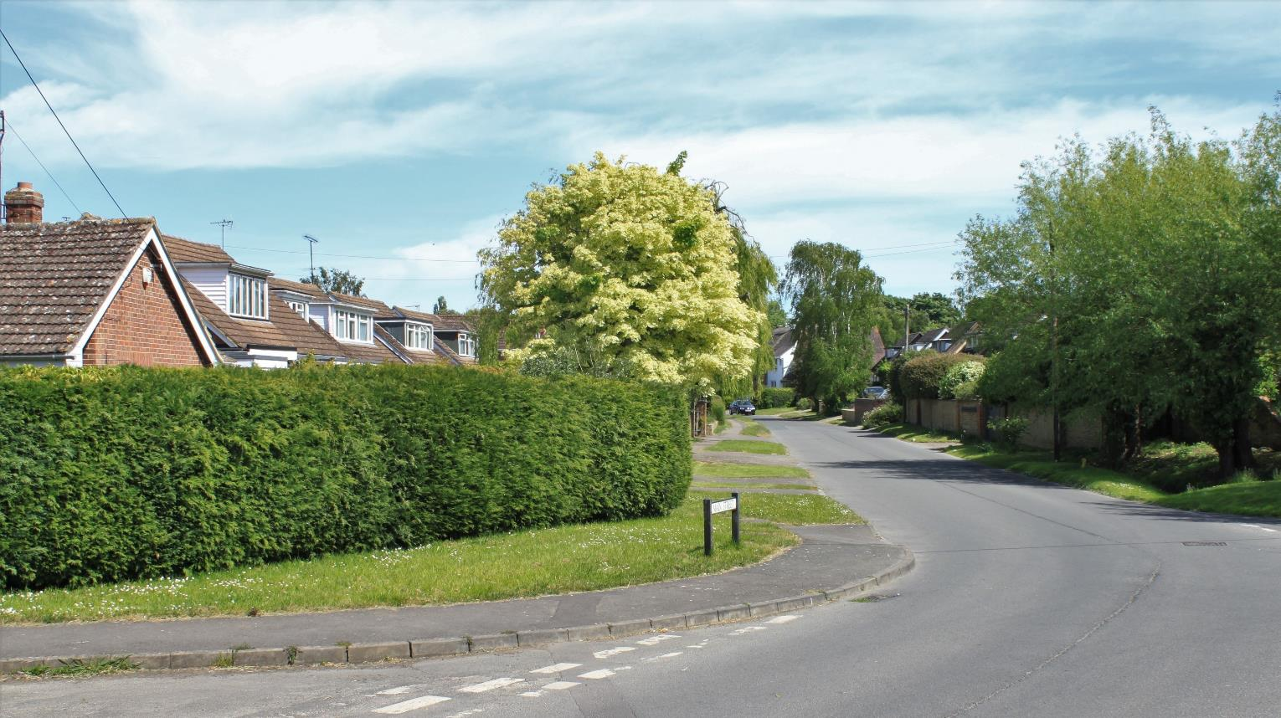

Slide 25
Main Street
This photograph of a row of cottages half way down Main Street on the right is at least 100 years old.
They were probably not seen as having any great historical or architectural significance, had leaking roofs, lacked insulation and any utility services. So, in the post WW2 era, who would argue against replacing them with modern housing?

Slide 26
Main Street
But even as far back as 1943, the Country Life article commented that
“if well cared for, such primitive construction will remain sound, a comfortable home and pleasing on the eye”.
In any event, nearly all were demolished in the early 1960s.
Yes, such an act might not be permitted now, but housing decisions sixty years ago were simpler!

Slide 27
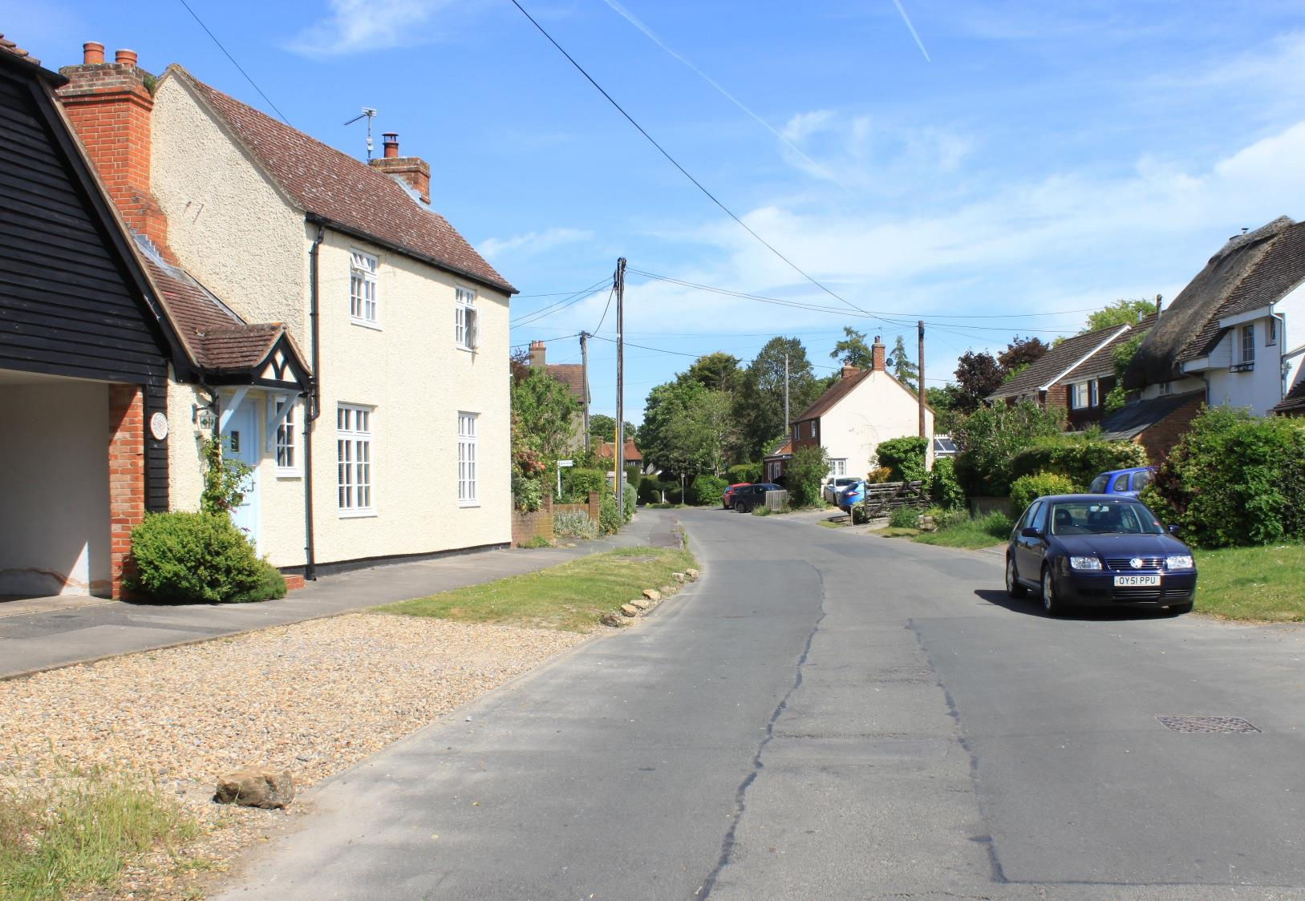

Slide 28
Carters Close
Immediately after, you pass Carters Close on the left.
From the amount of timber used in its construction, it seems likely that it was originally built for a yeoman farmer.
Sometime in the 1800s the house was transformed into three cottages for farm-labourers working at Lydbrook Farm.
The long front garden would have been used for growing fruit and vegetables.

Slide 29
Carters Close
The cottages were requisitioned by the army during the Second World War.
The land was registered in 1939, and sold for £175 in 1947 to one Lady Allen of Chichester, an early enthusiast for preserving old properties.
Cecily Dix, the lady shown in the photograph, lived in the end cottage. It became a single private house in 1958.

Slide 30
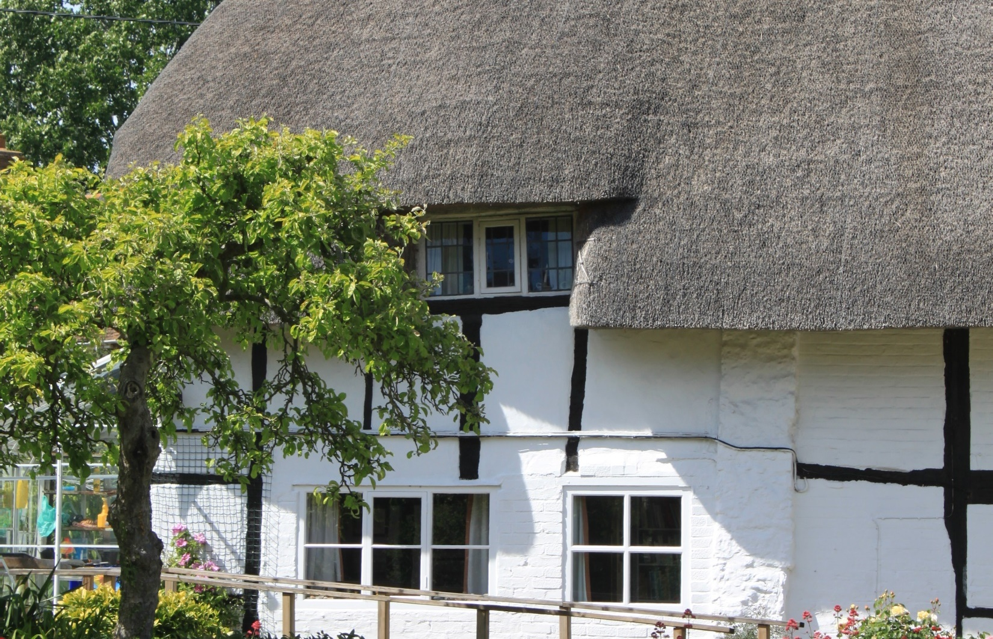

Slide 31
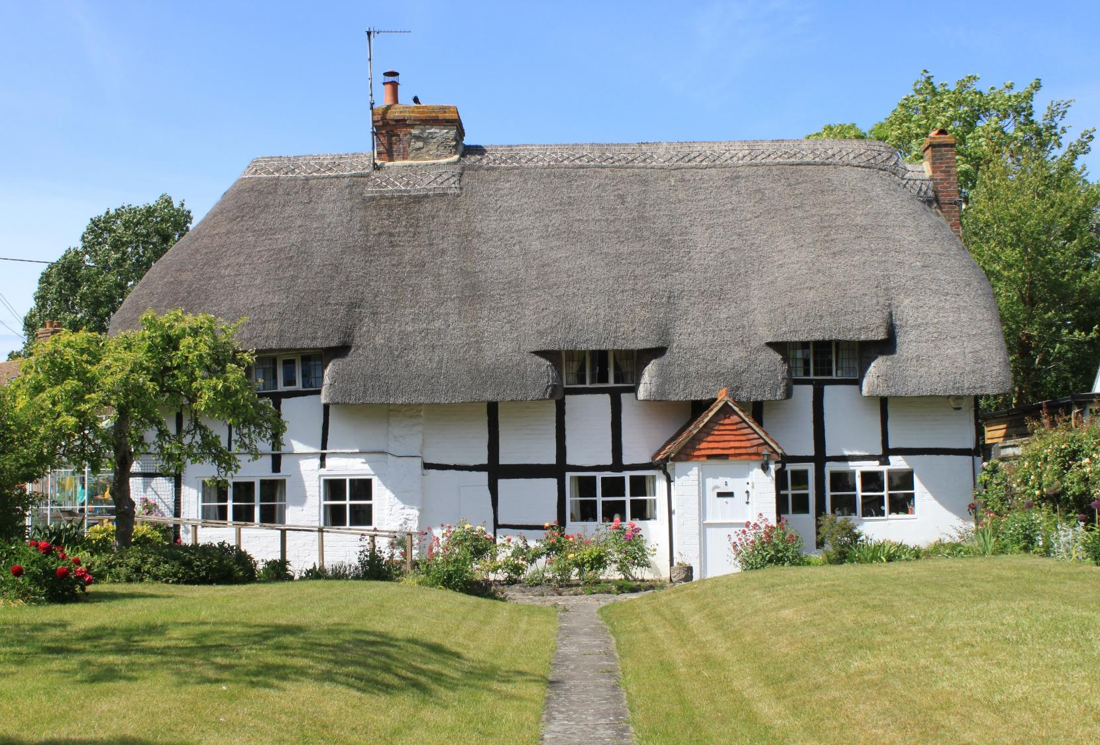

Slide 32
Barrett’s Yard
Carrying on down Main Street you pass Rascarral House (previously called Westholme) and The Villa on the corner of North Green.
They were both built by John Parker Barrett (JPB), who moved to West Hanney from London in the 1890s, and set up his building business in North Green.

Slide 33
Barrett’s Yard
This aerial photograph shows the business still in full swing in the late 1950s/early 1960s – occupying most of the land between North Green and Winter Lane.
The Villa was built in 1895 for JPB himself, then Westholme (Rascarrel) in 1921.

Slide 34
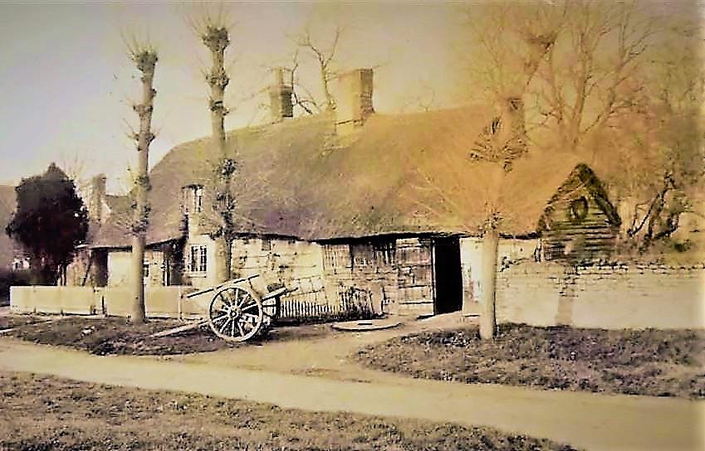
The Old Forge
On the other side of North Green you pass on your left a recently restored house called The Old Forge.
But this location goes back many years, as you can see from this photograph, and the two earlier pictures across the Green.
This original forge building burnt down in the early 1920s, but there seems little information on its history.

Slide 35
The Old Forge
The current black and white Old Forge was also built by John Barrett around 1926, for his sister, Ivy.
Barrett’s generated electricity for the business in the early 1920s. During the day the electricity powered the machinery, but at night the power was transferred to the three houses - eighteen years before it was brought to the rest of the Hanneys!

Slide 36
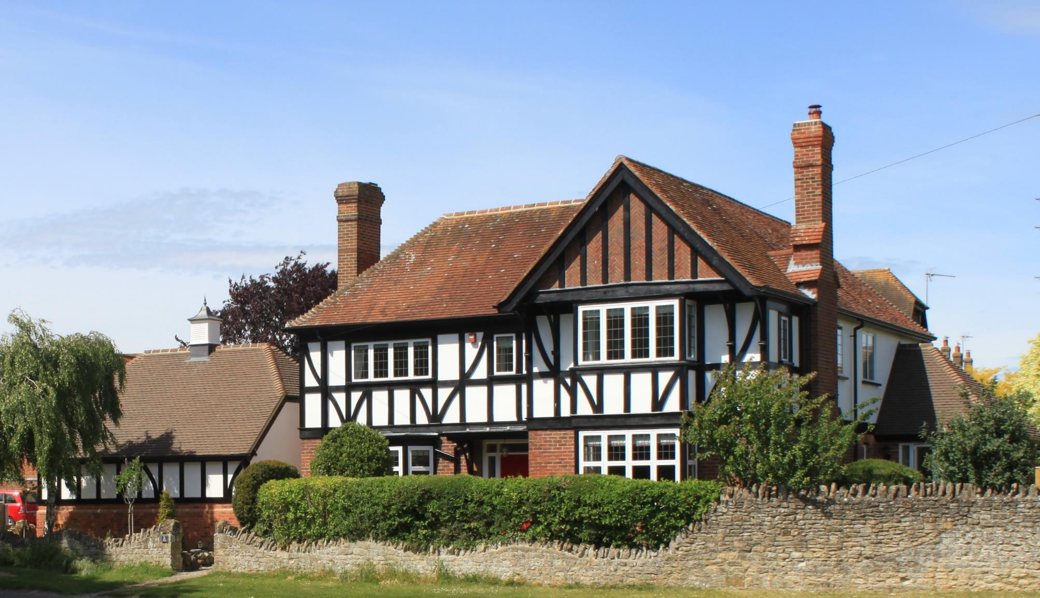

Slide 37
The Lamb Inn
We pass Castleacre on the left, one of the oldest houses in West Hanney, and unusual for having a slate roof - from Stonesfield near Woodstock.
Next, we reach The Lamb (now Hanney Spice) which has been serving West Hanney for many years, maybe as long ago as the 1850s.
In 1887 the Boor Family became landlords, and William Boor is shown in this photograph.

Slide 38
The Lamb Inn
This building burnt down in 1935, while William was landlord, but was rebuilt and handed down to his son, John.
Some years ago, a neighbour found a silver WW1 medal inscribed “W Boor” while digging the garden, presumably lost in the fire. This was returned to the Boor family.
The pub became Hanney Spice in 2011, a popular family owned business - “bringing you the taste of authentic cuisine from the Grand Moghuls”.

Slide 39
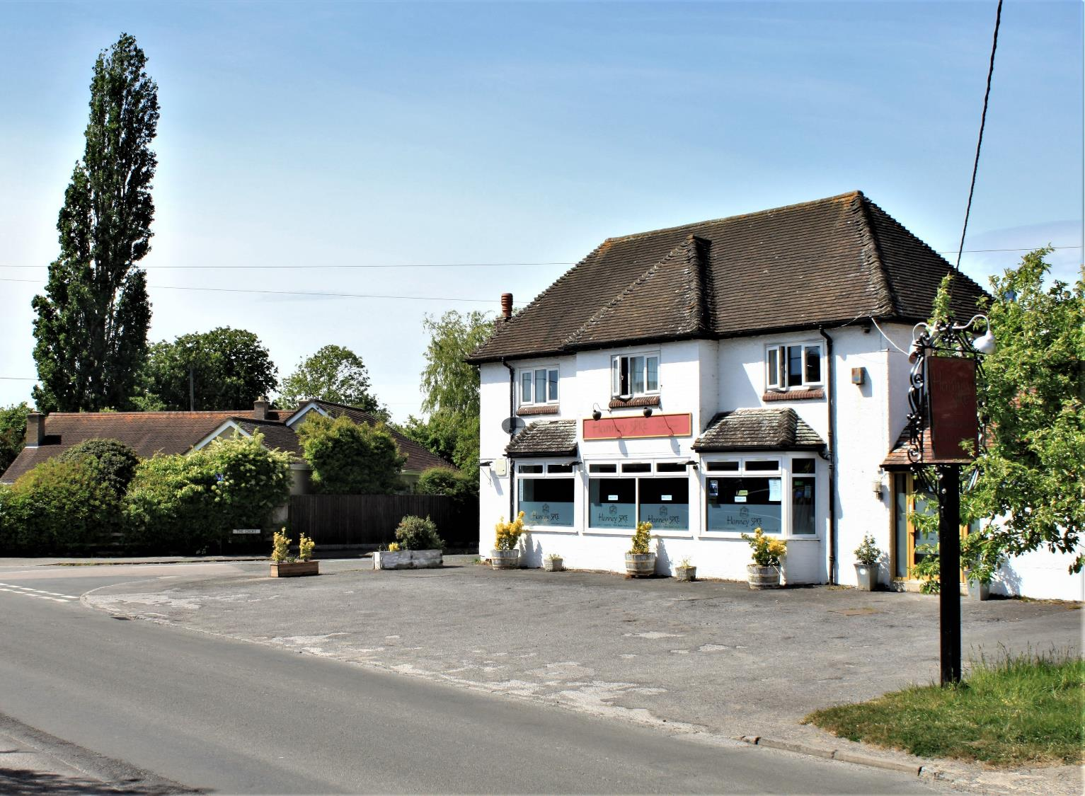

Slide 40
Hanney School
Back along the Causeway we pass Hanney School.
In 1811 the Church of England formed the “National Schools for Promoting the Education of the poor in the Fine Principles of the Established Church”.
Hanney National School was one of these – although the present building dates from 1840.

Slide 41
Hanney School
A School Log Book has the opening entry dated 26 June 1865:
“School commenced this day under the new master James Stone, 2nd class certificated, and Jane Wickes, sempstress”.

Slide 42
Hanney School
But some things don’t change!
On 31st January 1872, water was “nigh upon a foot deep along the road from East Hanney. Only 12 children present.”
And
As a result of a measles epidemic in 1902, the Chief Medical Officer wrote:
“I visited Hanney and conclude that your school better be closed at once.”

Slide 43
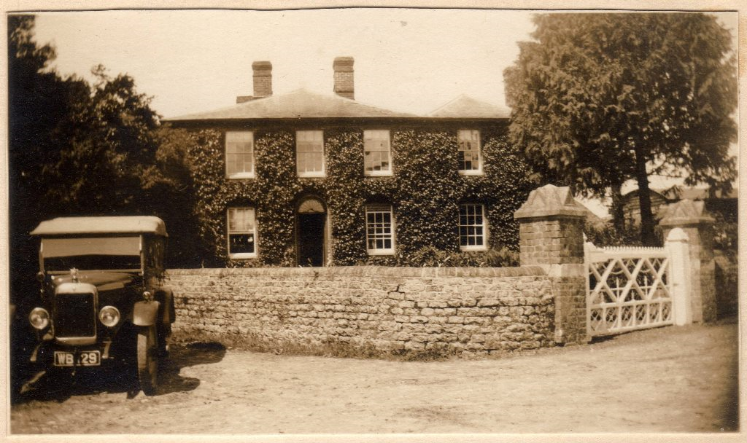
Old Mill House
Turning right at the Hall, and walking down Brookside, we come to the Old Mill House at the corner.
This was built in the mid 19th century as the home for an early member of the Dandridge family, who had bought the neighbouring Mill after it went “bust” in the late 1830s.
We know from a Hanney Parochial Magazine dated May 1877 that
“Mr Dandridge was sitting on the bridge when, a horse and trap passing, the horse was frightened and dreadfully crushed his leg”.

Slide 44
Old Mill House
In the 1950s Anne de Winton transformed the Mill House into a Country Club,
“frequented by Oxford dons,
local landowners,
and racing people from Lambourn - especially after a win!”
Osbert Lancaster and John Betjeman were said to be regular visitors … as well as the Kray twins!

Slide 45
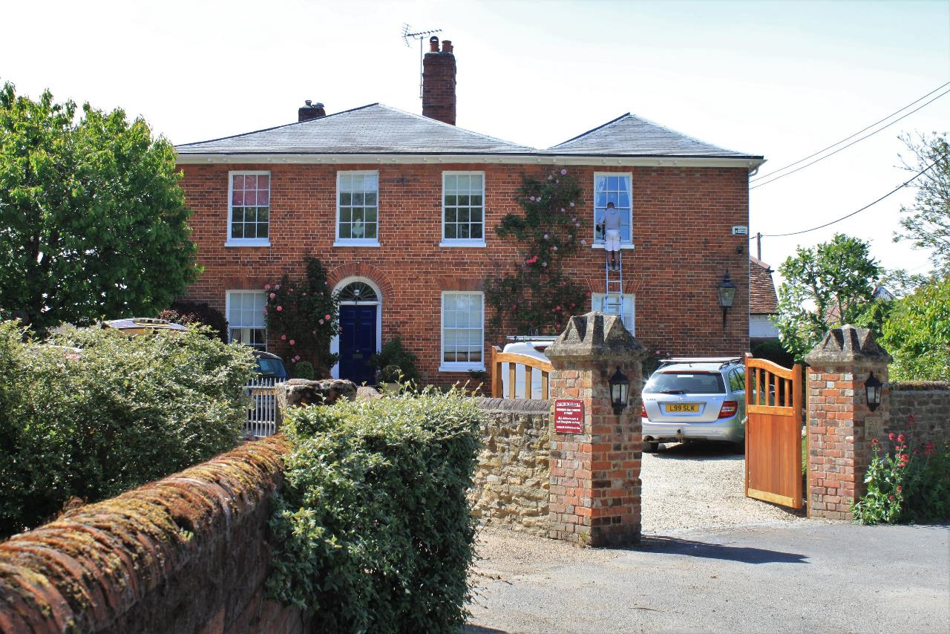

Slide 46
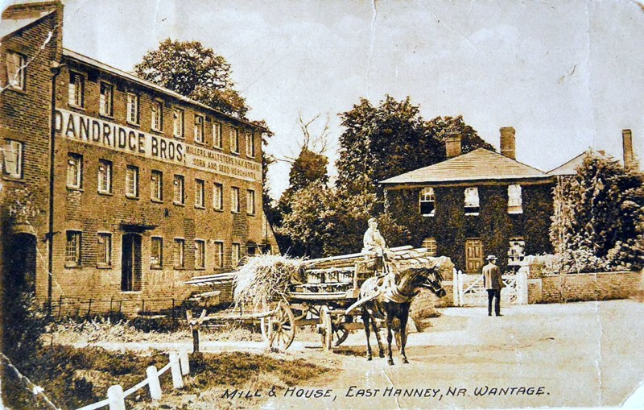
Dandridge’s Mill
Opposite you now is Dandridge’s Mill.
Mills have been on this site for centuries, and the current building dates from 1820, when it was a silk mill.
Church records note the death (crushed by machinery) of Thomas Stallard, aged 8, in 1828.
It was not a successful business, and it was derelict by 1839.

Slide 47
Dandridge’s Mill
It became a profitable grain mill later, and wagons with three carthorses carried loads to Witney and Oxford. Sometimes the driver fell asleep on the homeward journey and the horses knew their way back home!
It eventually closed in the 1930s.
In the Second World War it was referred to as a “secret factory” to manufacture parts for Mosquito bombers.

Slide 48
Dandridge’s Mill
In the 1960s it became the home and studio of
“Pud” Farmer, a sculptor – or “construction artist” as he preferred to be known. Several of his works exist in various Hanney homes.
Again in danger of becoming derelict, it was recently converted into three flats and The Wheelhouse.
.
But the stream is still used – to provide electricity now.

Slide 49
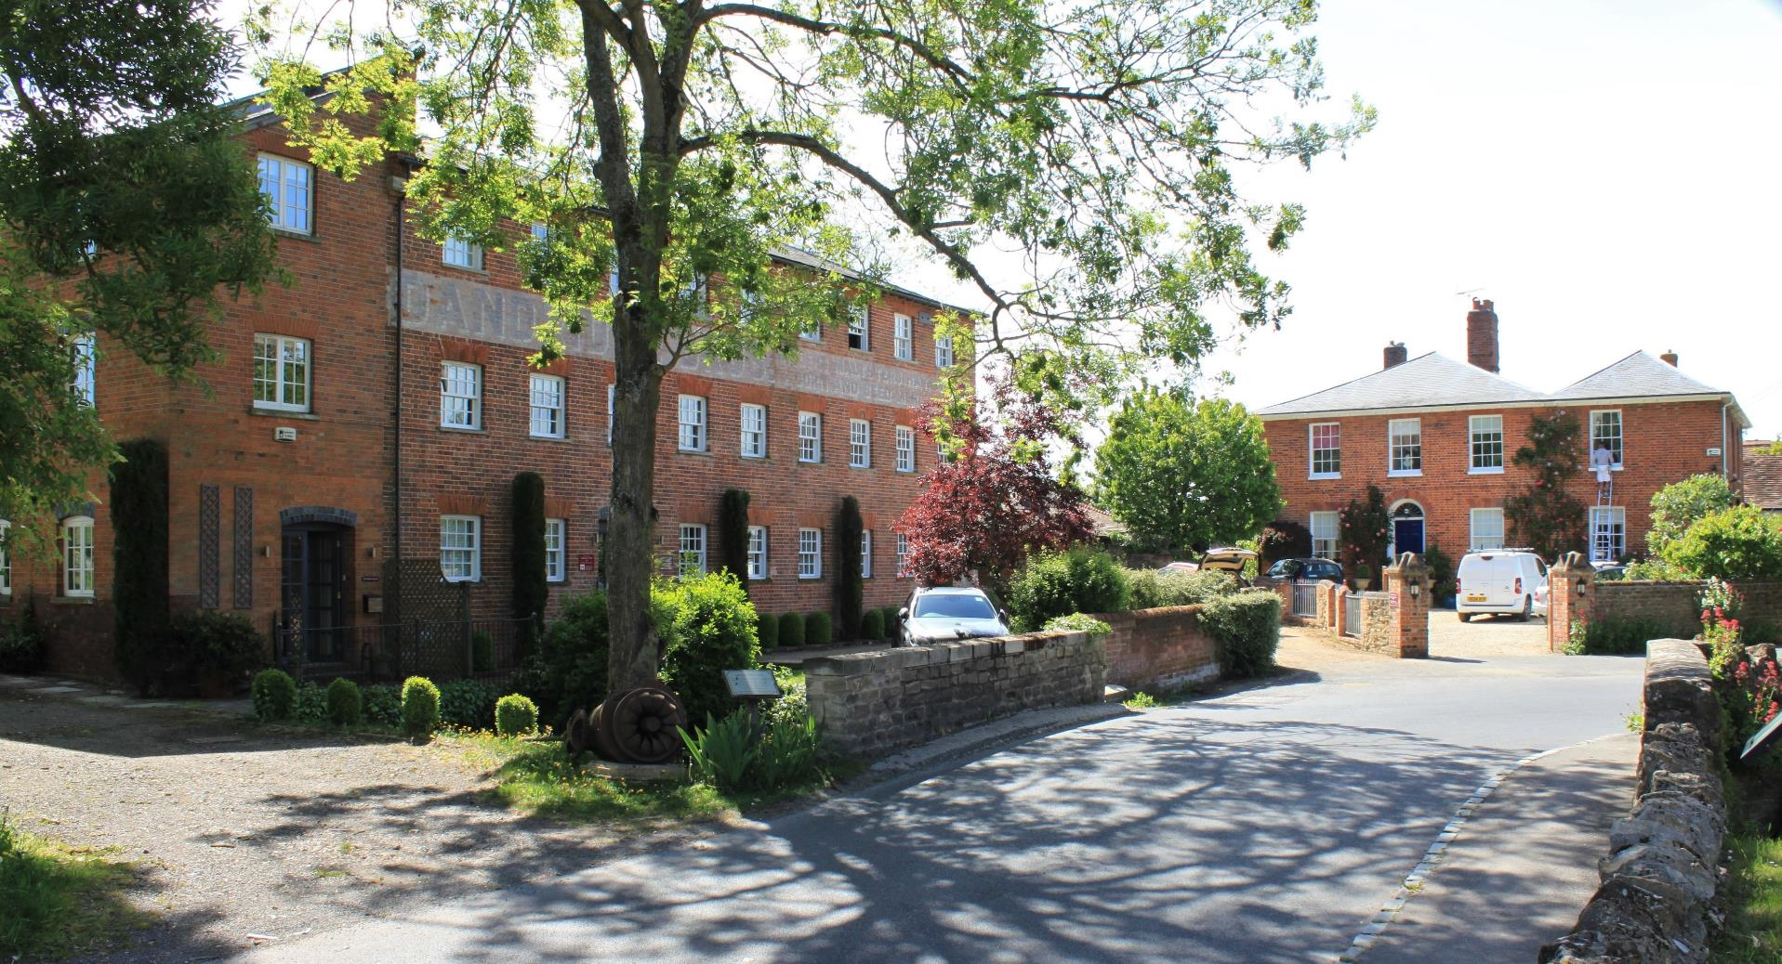

Slide 50
Hale Cottage
Hale Cottage, next on the left, was named after Jonathan Hale, whose name appears in the East Hanney Enclosures from 1803.

Slide 51
Hale Cottage
Charles Aldworth moved to Hale Cottage in the 1850s as a carpenter and coffin maker – known for “doing a beautiful funeral”.
Next door but one, the house now called Yew Hedge was until recently called 'Sawpits’. Timber was sawn by two men using a long saw over a sawpit - and that’s where the term “top dog” originates!

Slide 52
Hale Cottage
But from a History Group perspective, of more lasting significance was that his son, Alfred Aldworth, collected a batch of “Hanney Parochial Magazines” from 1874 to 1895
– which by good fortune remain to this day, and were donated to us in 2016.

Slide 53
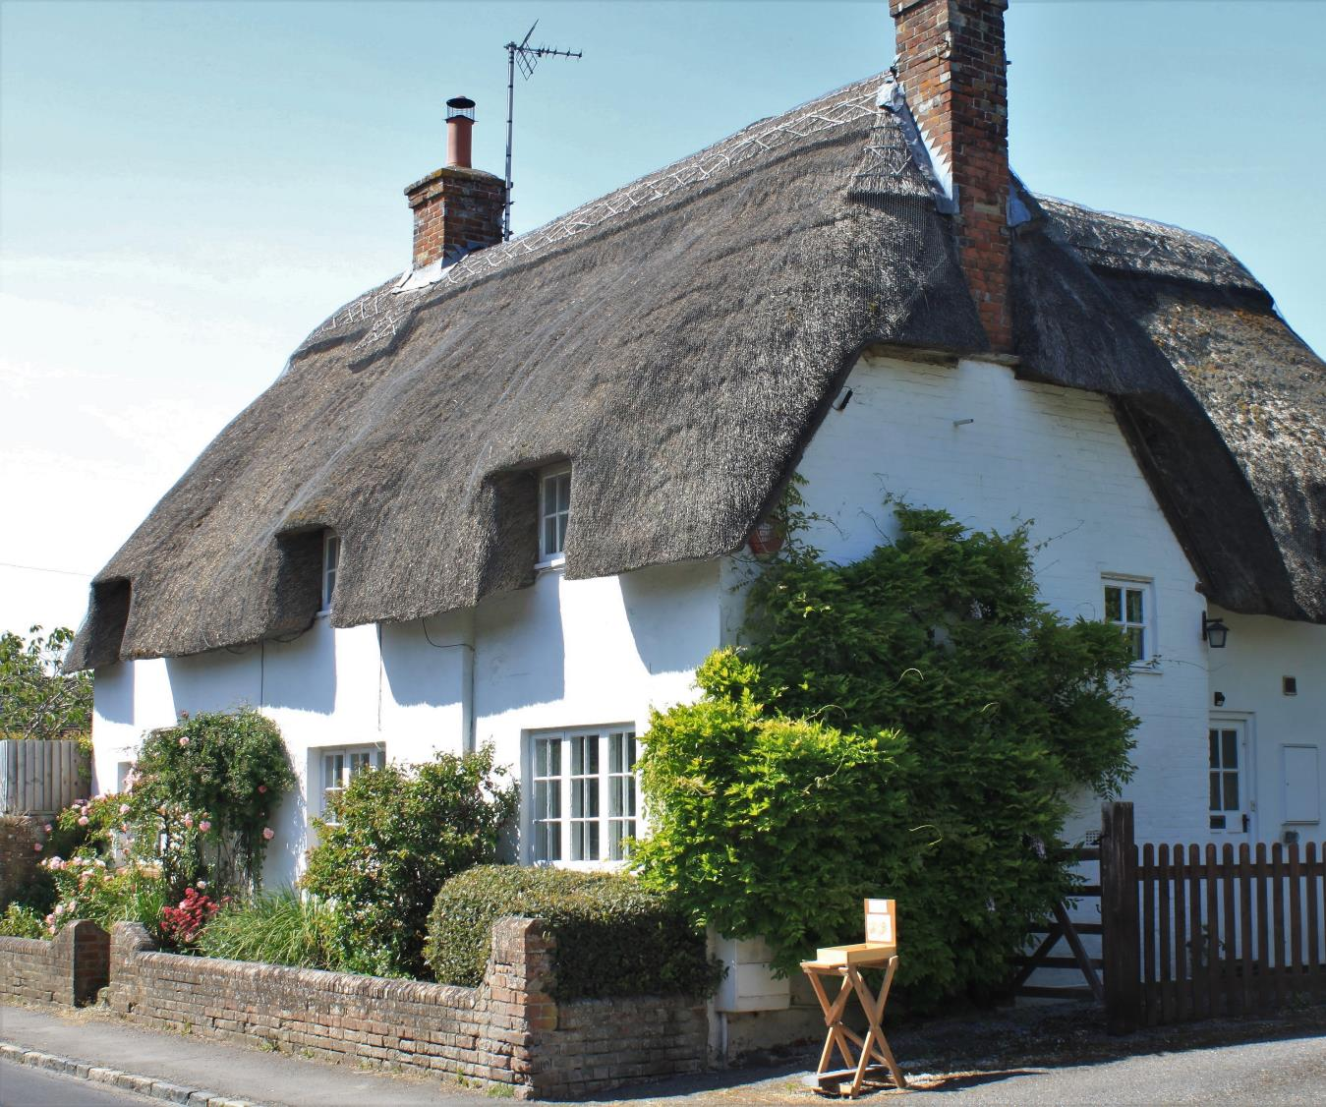

Slide 54
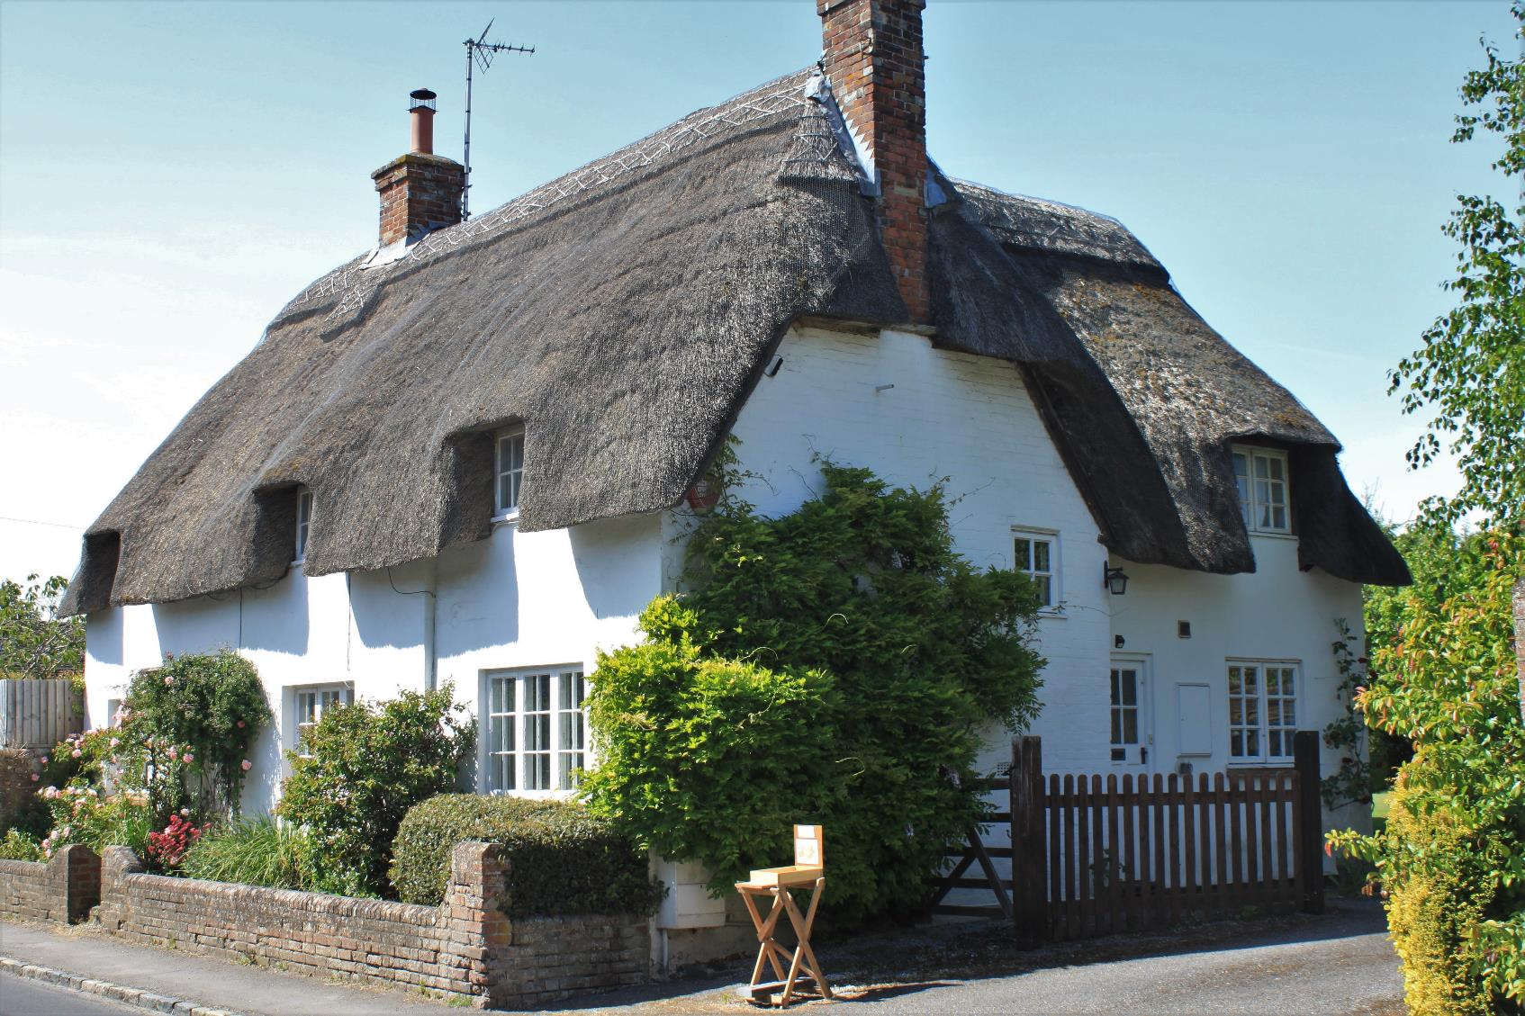

Slide 55
The Mulberries
Near the corner of Main Street is The Mulberries.
It is most famous as the home of James Holmes, who moved to Hanney as a schoolboy in the 1860s.
He became a well-known character – seen here with the author H G Wells.
A committed “Malthusian”, he was concerned that rapid population growth would only be checked by starvation.

Slide 56
The Mulberries
To prevent this, he published a booklet “True Morality” which promoted contraception, and he established a business selling contraceptives – delivered by bicycle from Hanney to the Post Office in Wantage. His stores were kept in Hazelwood further down Main Street, which he also owned.
For this he was prosecuted both in Abingdon and Reading.
But he was a considerable benefactor to Hanney, as you will read later in the walk.

Slide 57
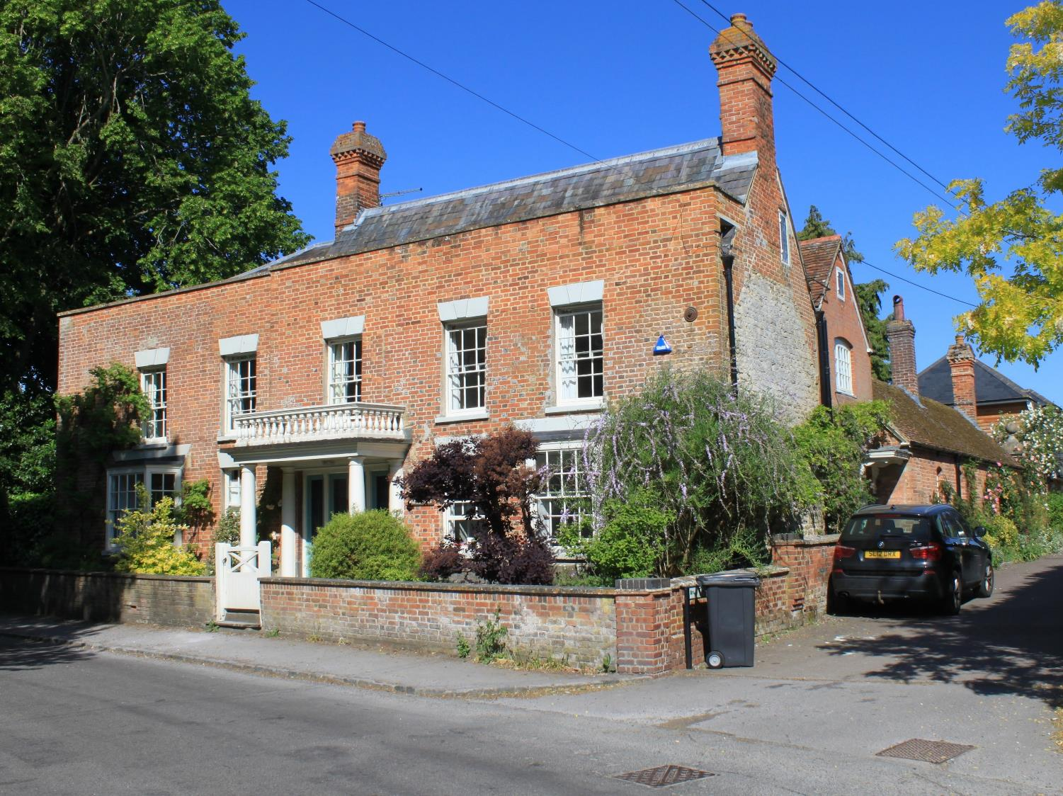

Slide 58
Towards the Black Horse
The photograph, probably dating from the 1890s, shows the view down to the Black Horse, with what is now called Jasmine Cottage on the left.
But in the East Hanney 1861 Census things were rather more crowded, with eight properties on the site and a total of 87 occupants. All the heads of household were described as Agricultural Labourers, with all but one born in East or West Hanney.
Four of the wives were also born here – but one came from Ireland! In total there were 27 children.

Slide 59
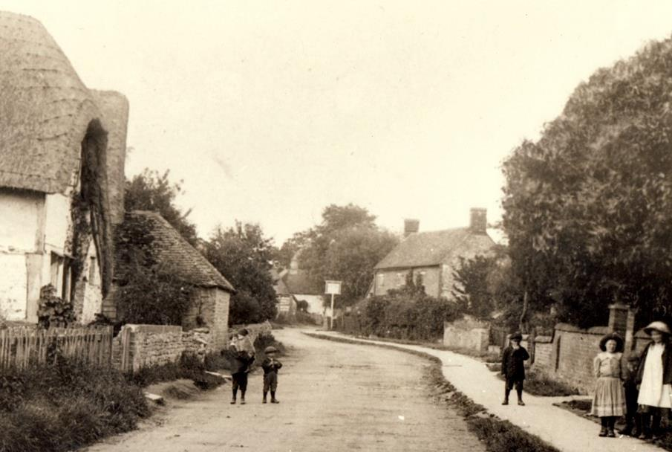
Towards the Black Horse
The Black Horse (or “Kicker”) has been a centre of village life for years - but caused a storm in 1998 when the original “Flemish Bond” local brickwork was overpainted with thick white paint.
Vandalism?

Slide 60
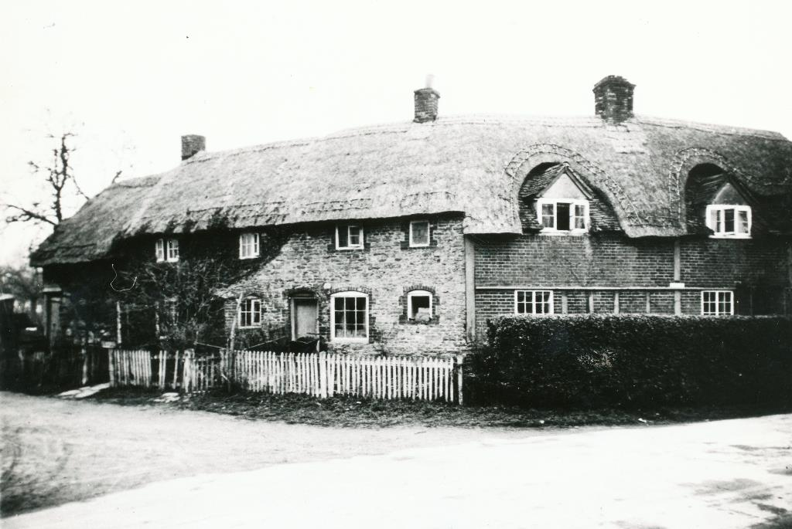
Lilac Cottage
Lilac Cottage, on our left, probably dates from the late 17th century, but the photograph here shows two dwellings attached, and it is unclear whether they date from the same time.
It shows how rundown many cottages became. The part of the dwelling on the left was demolished as late as the 1960s.
Like many houses it used to be called after the family living in it - “Godfreys”. William Godfrey, who lived here in the beginning of the 20th century, died in the First World War.

Slide 61
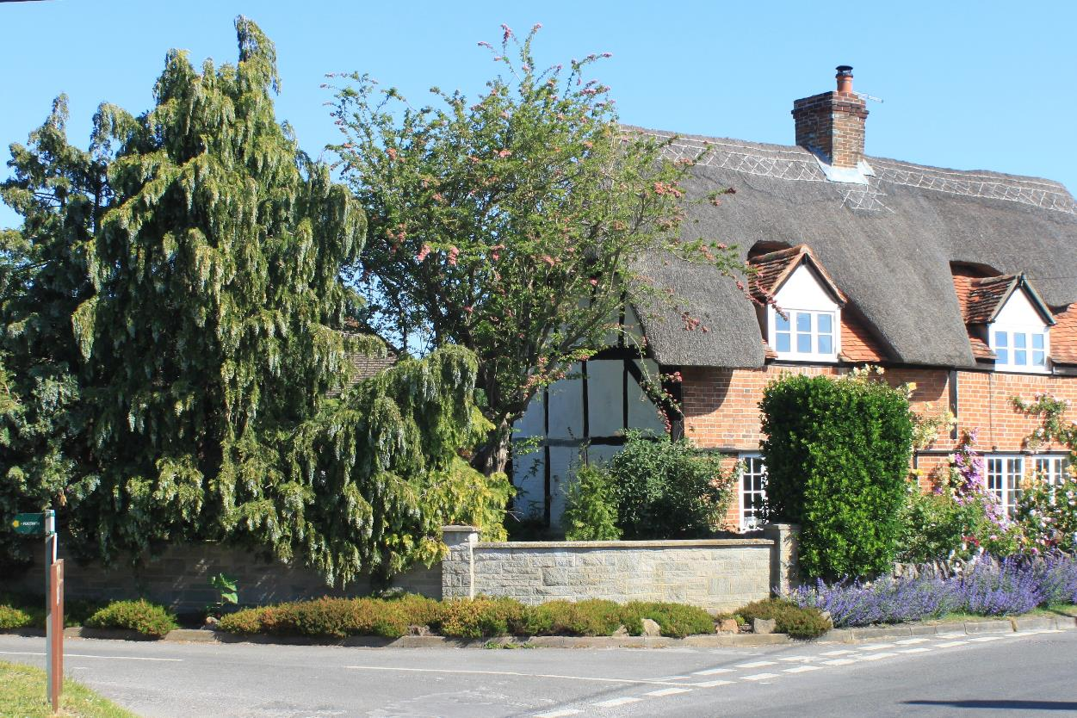

Slide 62
Hanney Chapel
The picture here shows children in their “Sunday Best” outside Hanney Chapel.
The chapel dates back to 1862, when it was erected by the ‘Frilford and Longworth Home Mission’ in an architectural style we also see in Steventon and Stanford.

Slide 63
Hanney Chapel
The first minister, Mr Broughton, moved from Abingdon into Chapel Cottage, where he also kept a shop. The locals called it ‘Broughton’s Chapel and Cottage’.
When Mr Broughton died in about 1917 the chapel closed, and only reopened as a place of worship in 1943, then known as ‘The Mission’.
For a long time it had a thriving congregation and Sunday School, but by 1998 membership had dwindled to two. A local church sent ten of their members to revitalise the work, and the chapel is again an active community of local Christians.

Slide 64
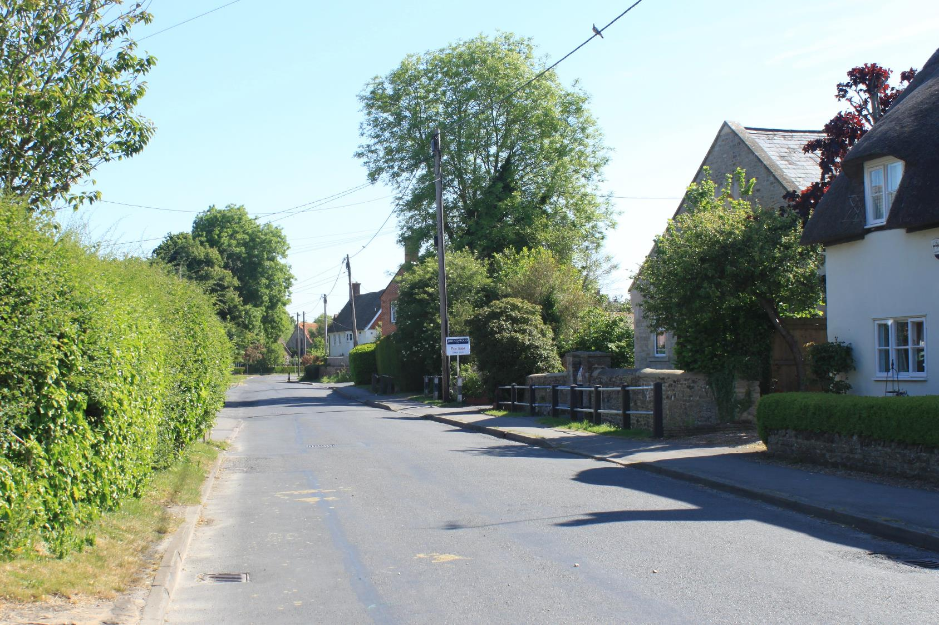

Slide 65
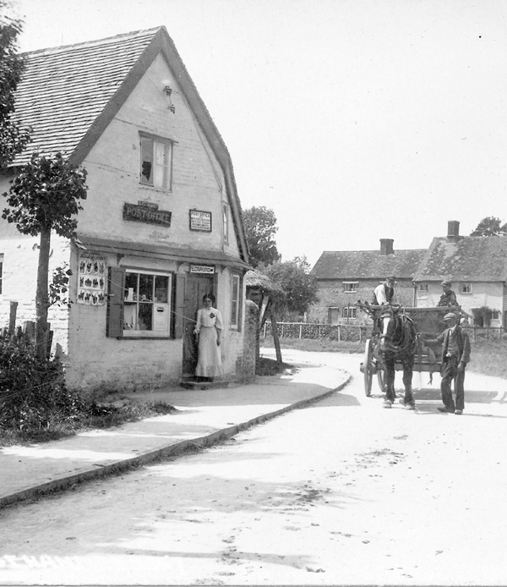
Post Offices
Continuing down Main Street, we pass The Old Post Office on the right – shown in the photograph.
The Miss Piggots lived here, and delivered the post. Their brother was a cobbler.
Another Post Office existed by the current post box, in Dorley House, opposite, with a shop known after its owner as Shepherd’s Shop. This closed around 1987, and lead to the establishment of the current Village Shop.
Next to Dorley House is The Old Bakery, once Lay’s Bakery, and then the home of Fred Harris, painter and decorator, until his death in 2001.

Slide 66
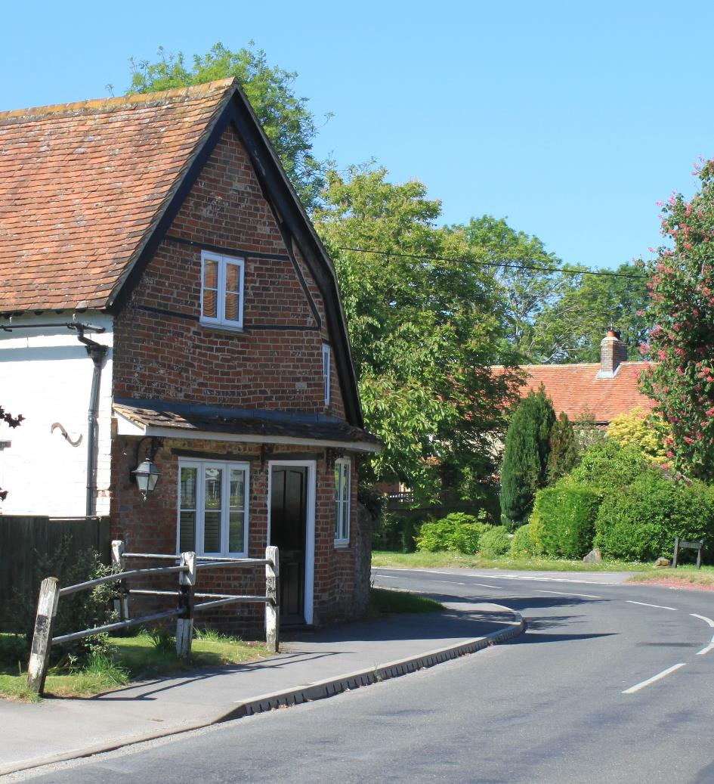

Slide 67
Post Offices
But in a few minutes, on the way to the Green, we will pass Cross Tree House. The photograph shows it also as a Post Office – which explains why there is an old telephone box directly outside.
Clearly they were not all operational at the same time, less than 50 yards apart, but why so many?

Slide 68
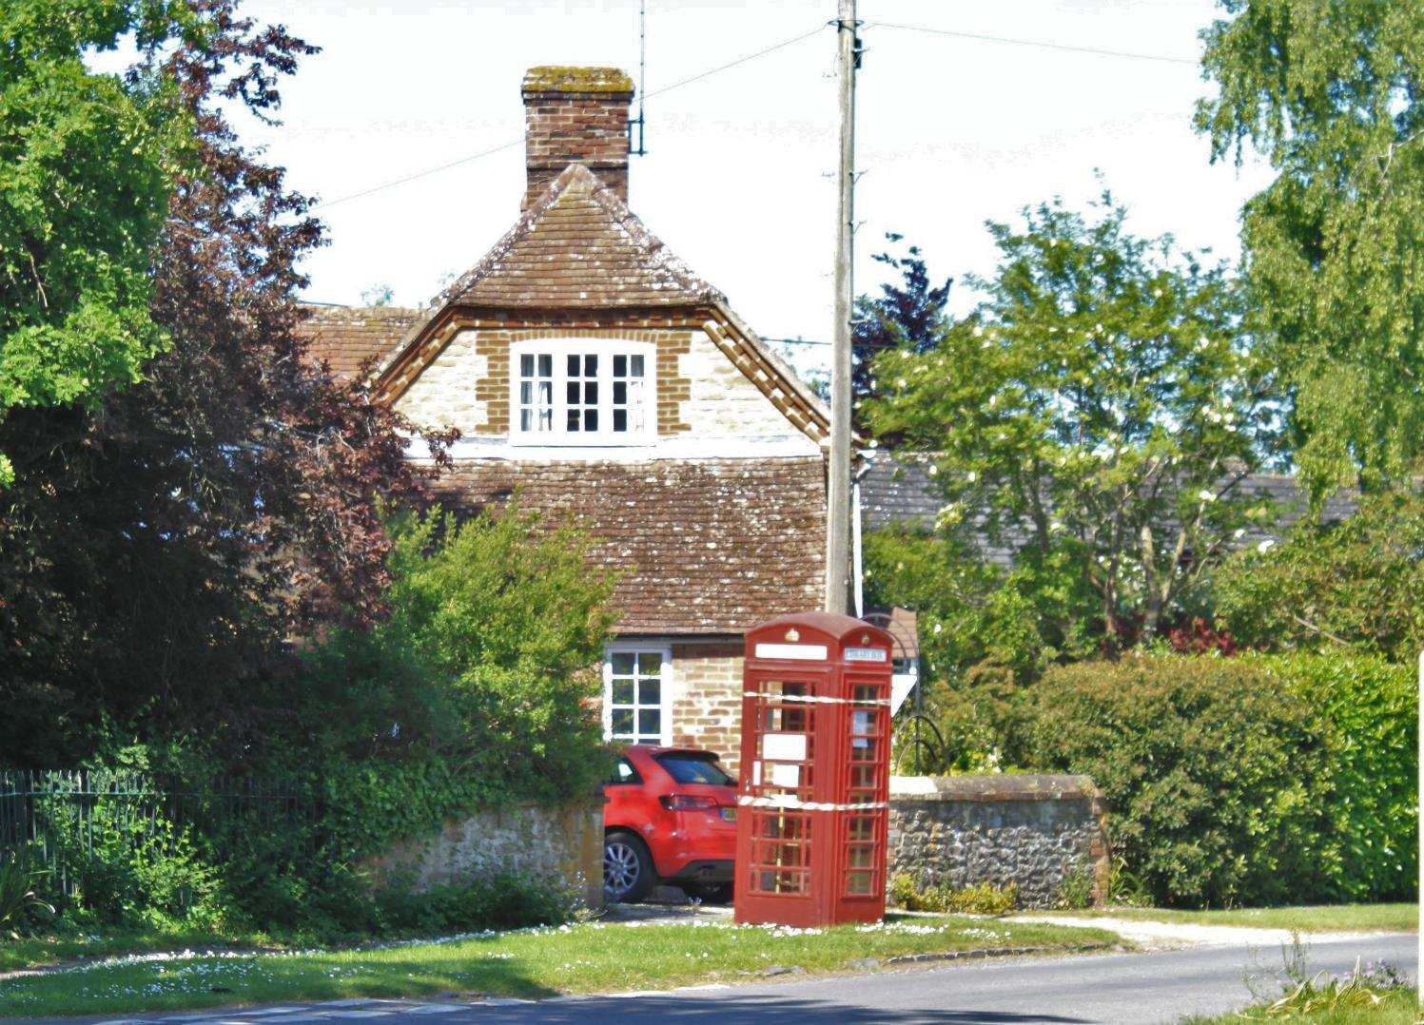

Slide 69
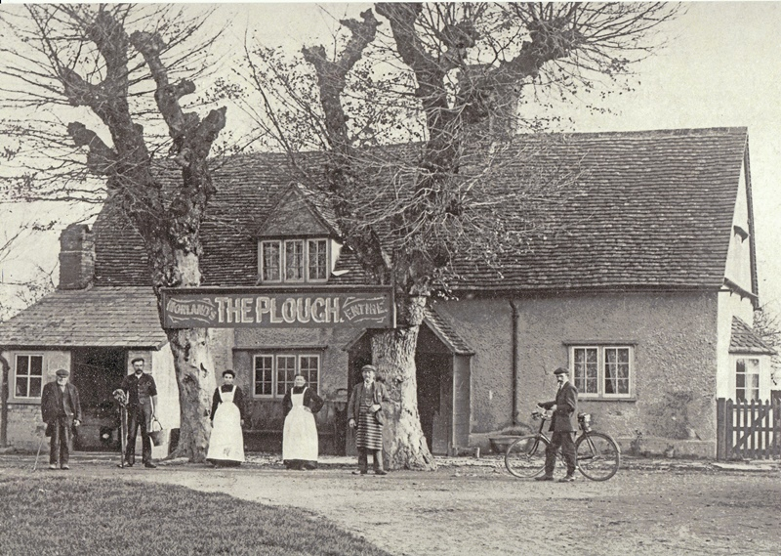
The Plough, now La Fontana
Without crossing the dangerous A338, La Fontana is clearly ahead.
But not that long ago East Hanney had its own Plough Inn – as shown in this photograph, maybe from the 1900s.
It continued with this name until the 1960s, when it became a restaurant, “The Vintage Car” (with a vintage car outside), but, soon after, the owner discovered that there was already one of the same name in Oxford, so it became simply “The Vintage”. It changed again to “La Fontana” (The Fountain) in the 1990s, becoming the Italian restaurant and hotel.

Slide 70
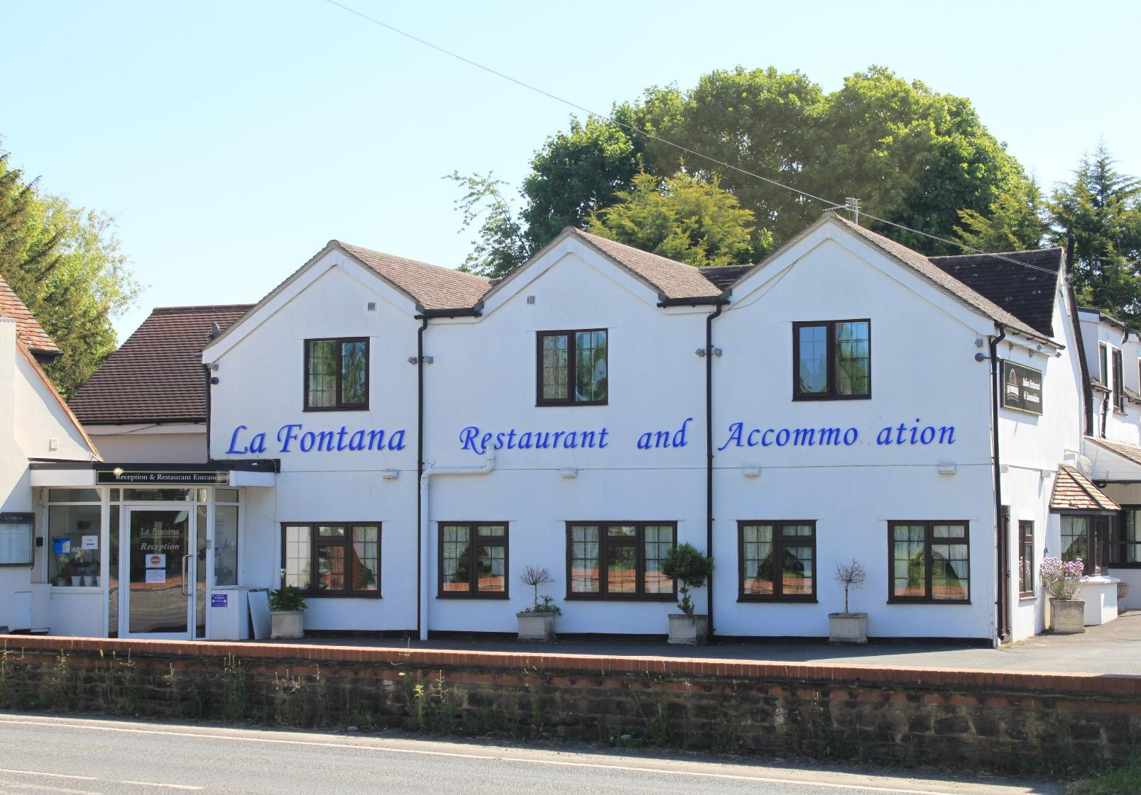

Slide 71
The Crown
But walk a small way up the A338 and on your left is…another pub, The Crown. Yes, until not long ago the Hanneys had five of them!
The landlords of The Crown seemed to flourish, as per this photograph of the Butcher family in 1904,
- although not actually taken at The Crown.

Slide 72
The Crown
The Crown seemed to play an important part of village life. In June 1877 the Hanney Parochial Magazine records
“The Hanney Foresters Benefit Club held their annual feast at The Crown on Thursday in Whitsun week. Headed by the Wantage Band the members walked in procession to the Parish Church where prayers were read and a sermon preached”.
It became a private house, The Old Crown, in 1997.

Slide 73
Five Shoot
Turning back, you are now at 'Five Shoot’. Some say it gained its name from an execution in the Civil War … but more prosaically, a meeting of five roads!
You can get some idea of the agricultural heart of East Hanney where, at the end of the nineteenth century there were nine working farms, and as many again in West Hanney.
Imagine how different the noises, smells, the roads and tracks would have been from dawn to dusk.

Slide 74
Five Shoot
In front you will see a railed off garden. This is where the ashes of James Holmes were laid to rest.
It was the site of a very old blacksmith business run by generations of the Cox family.

Slide 75
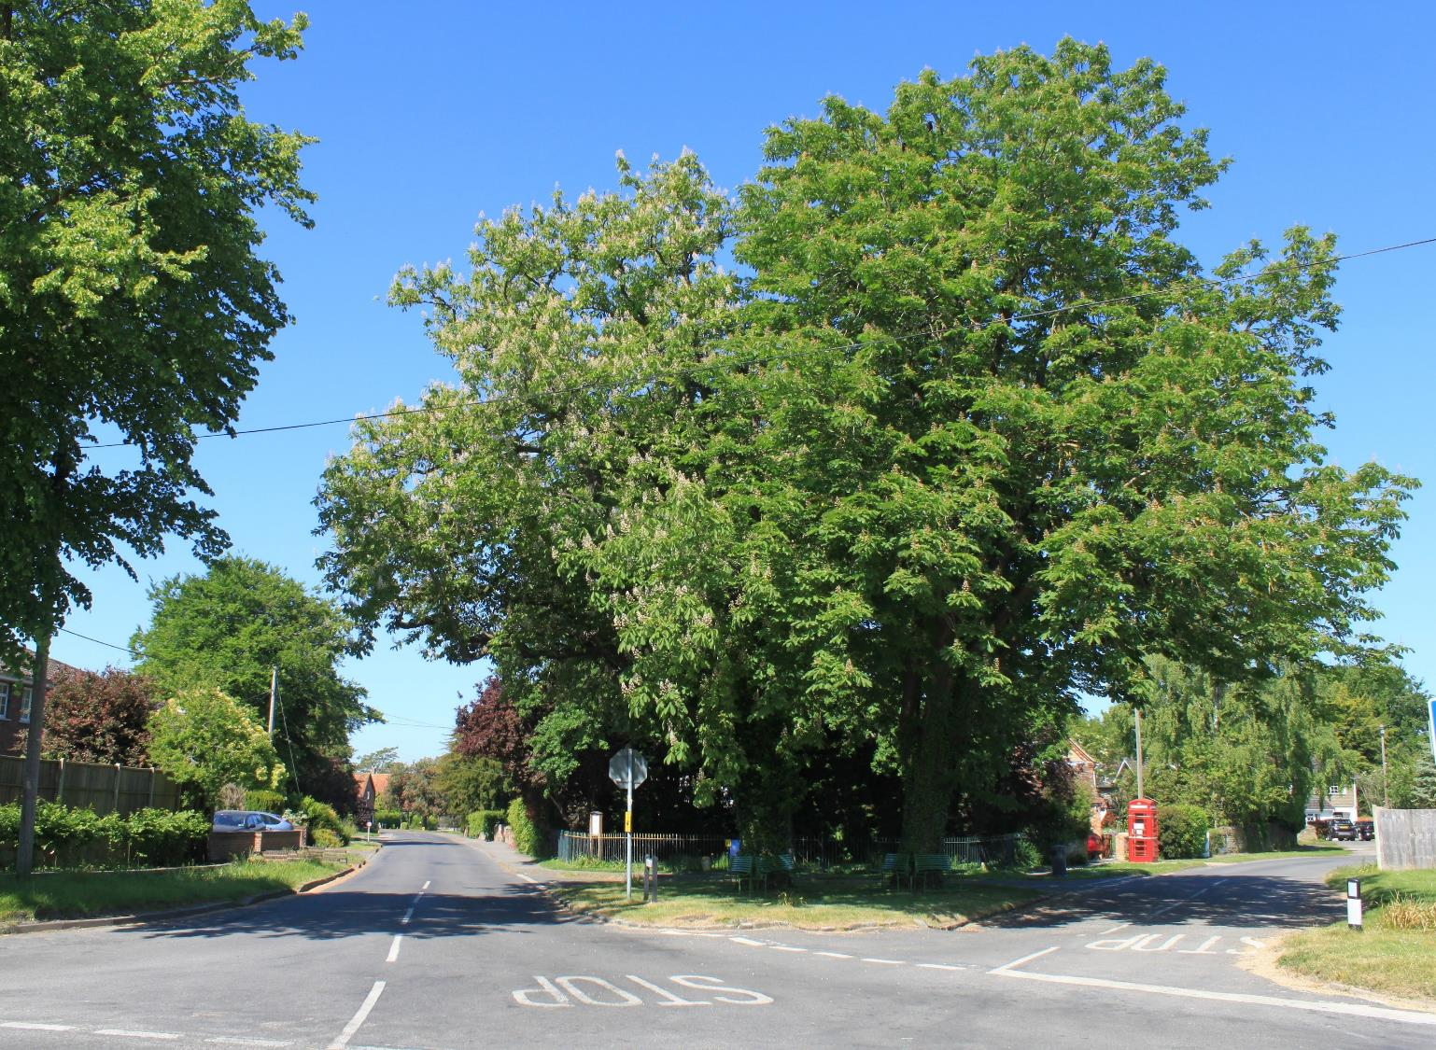

Slide 76
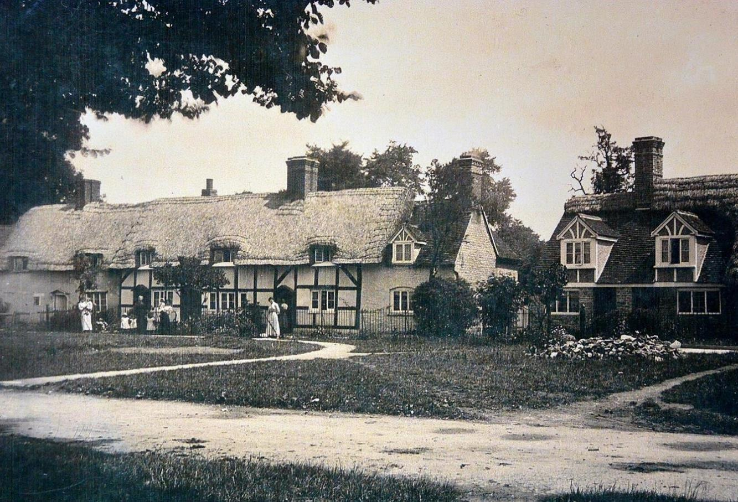
East Hanney Green
Heading to the right into East Hanney Green, we see a row of old thatched cottages.
In the late 19th century they were owned by James Holmes, and housed five families at very reasonable rents. Now there are only two cottages.
The cottages overlooked a sawpit, and a village swing erected by the Parish Council.
There was also an enormous spreading elm tree, so big it had a seat within it.
Every year a fair came, and Hanney Feast was a special few days which re-united families from near and far.

Slide 77
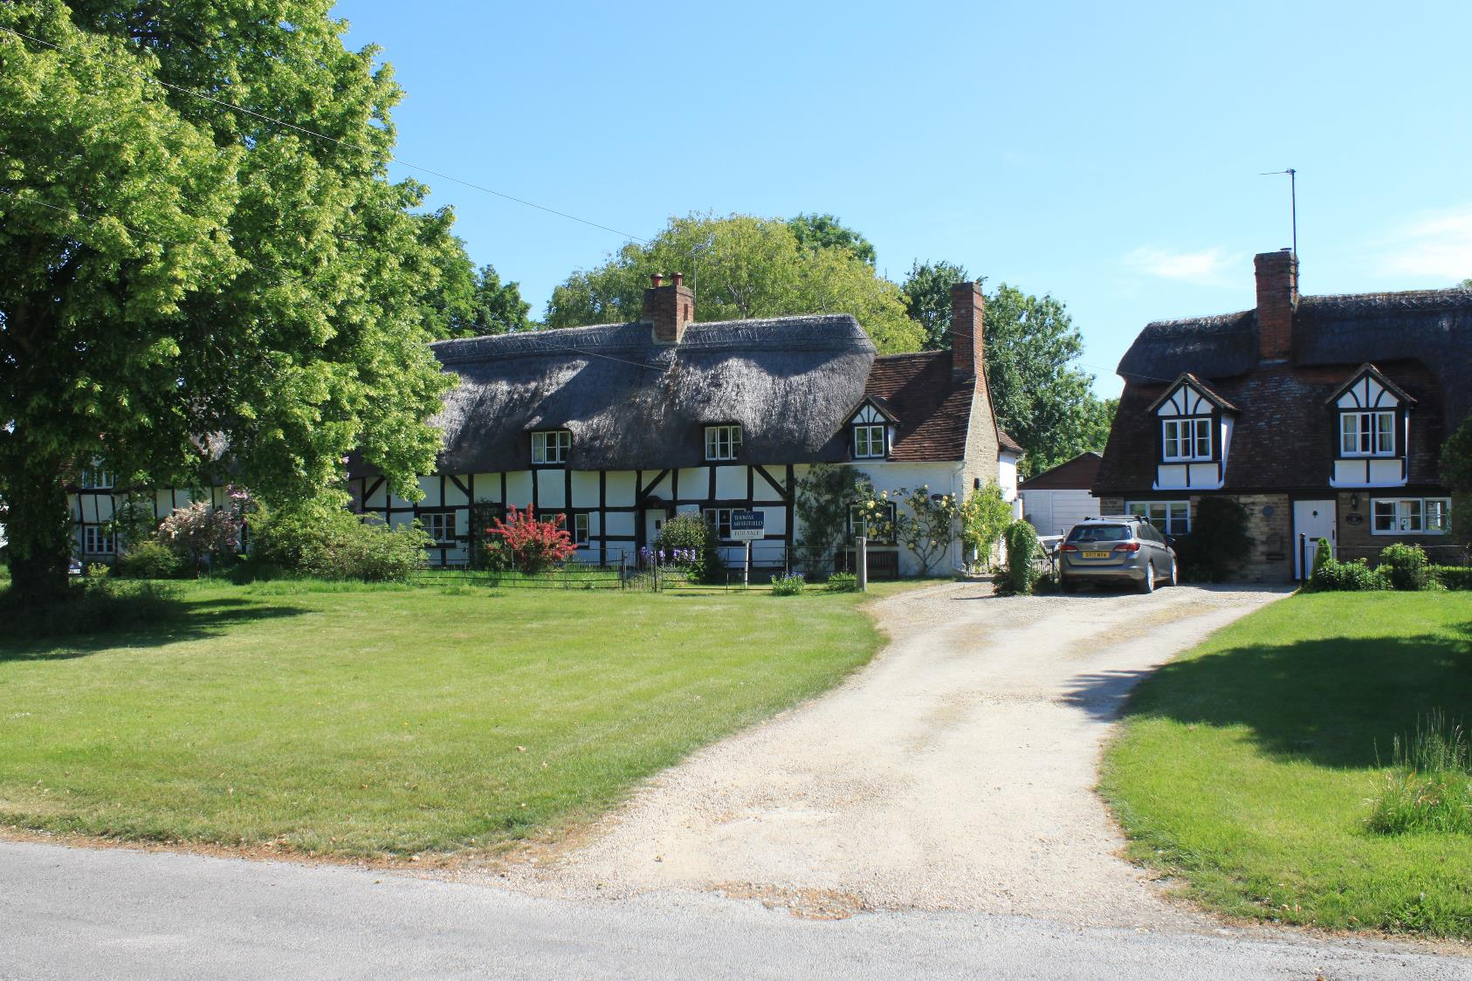

Slide 78
East Hanney Green
At the top of The Green we come to Varlins, a late Victorian house from 1889.
Further ahead, at the corner of Ashfields Lane, another bakery can just be seen – this one was run until recently by Ted “the Bread” Carter.

Slide 79
East Hanney Green
A surprise: in 1956 some old aircraft wings were found on the inside walls of the black wooden barn just visible to the left of the photograph.
Some were from Sopwith Pups and Camels – British WW1 single-seat biplane fighter aircraft. Others were from De Havilland DH10s, the British twin-engine bomber that just missed the end of the First World War.
Propellers from various aircraft were also found in the farm opposite.
All have been donated to two RAF museums.

Slide 80
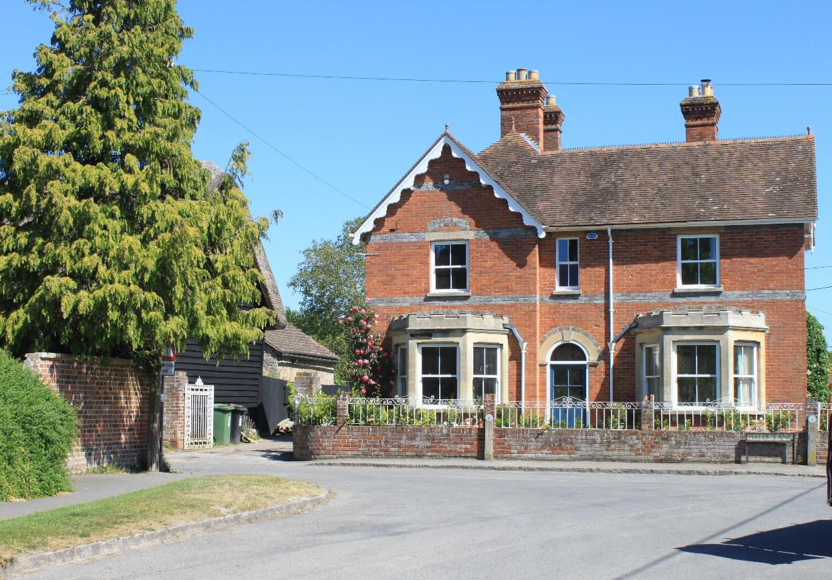

Slide 81
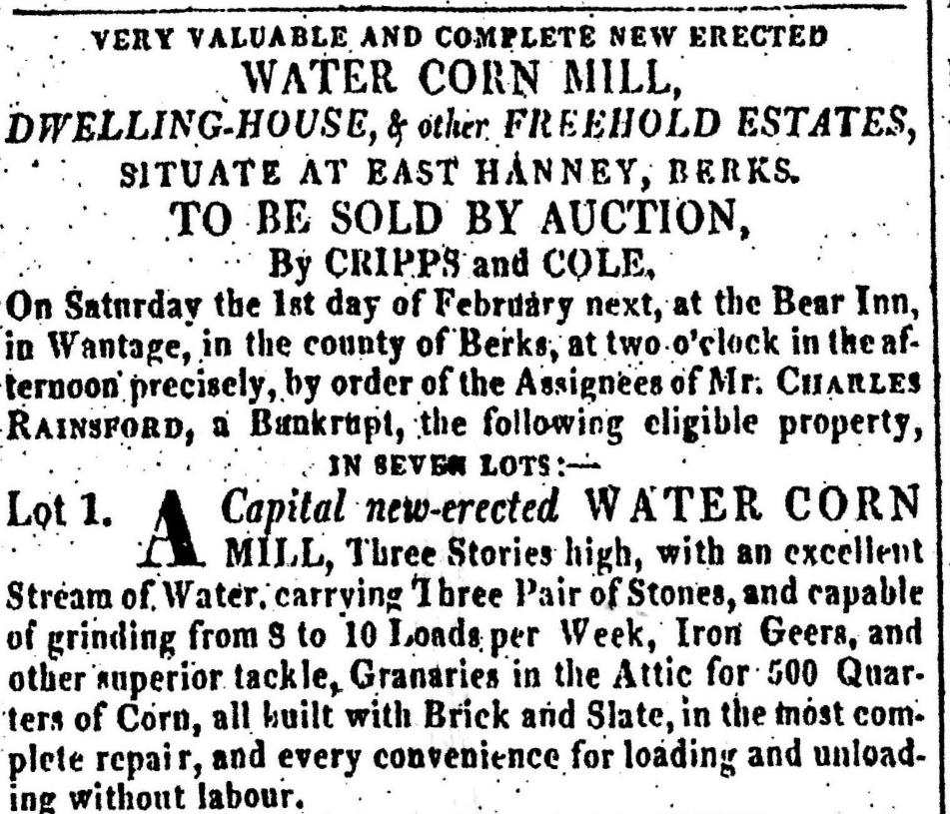
Philberd’s Manor, and Lower Mill
Walking left down Halls Lane we pass the entrance to Philberd’s Manor on the right.
Then we come to Lower Mill. This was built around 1812, on an old site, by Charles Rainsford, whose name is reflected in that of the nearby cottage.
As with Dandridge’s Mill, there is talk of it, or a previous site, being used as a silk mill – in this case by prisoners from the Napoleonic Wars. This seems unlikely, as certainly this building has all the characteristics of a corn mill.
But again, as with Dandridge’s Mill, it was not initially a commercial success, and Charles Rainsford went bankrupt. The photograph shows an extract of the sale documentation following his bankruptcy.
It was later run by the West family, but was burnt out in 1903 and not used for milling again. It is now a private house.

Slide 82
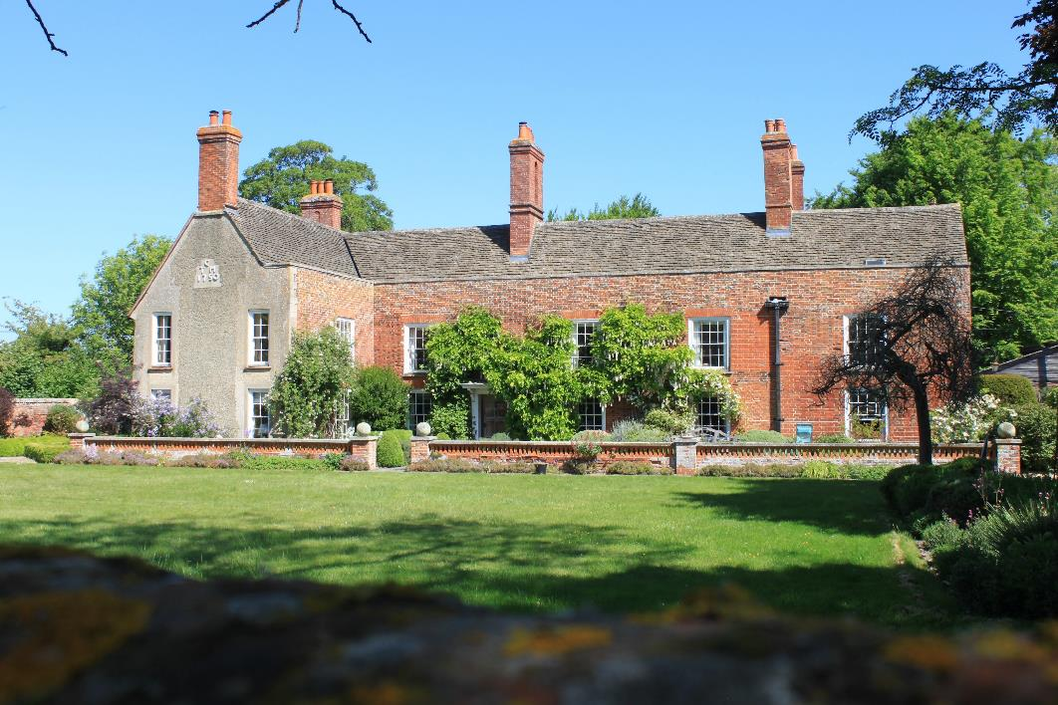
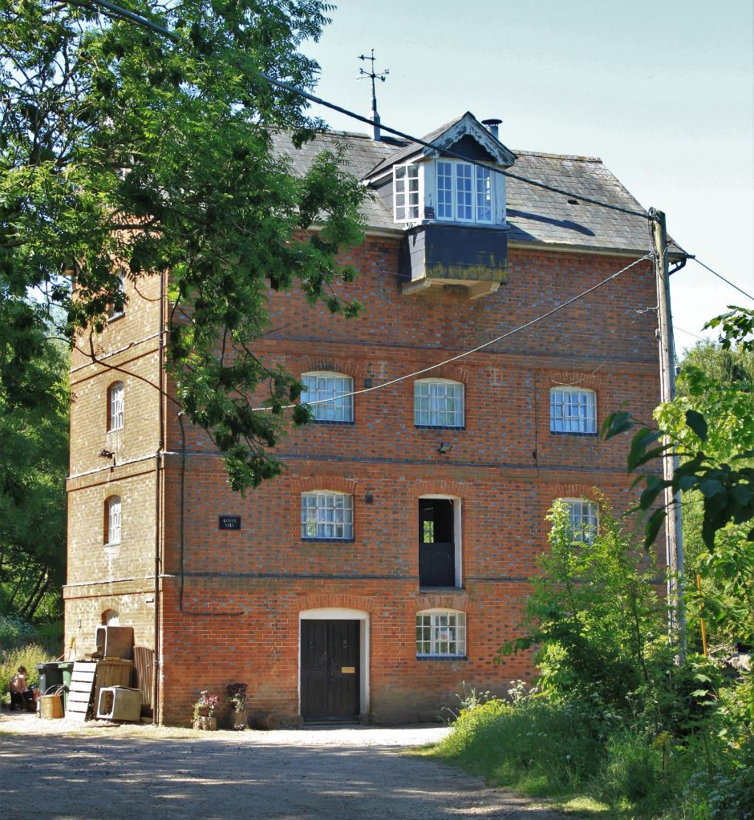

Slide 83
Letcombe Brook
Passing Lower Mill to your right, walk down the footpath at the side of Letcombe Brook.
But this is also not without history!
In 1896 a committee resolved to provide a bathing place between the Iron Bridge and Lower Mill. A “sturdy corrugated iron structure about 12 yards square was constructed…and the stream depth controlled by the miller”.
Access was via Snuggs Lane – then called “Bath Lane”.

Slide 84
Iron Bridge
We soon come to the “Iron Bridge” across the brook.
Read the signboard for the full story of the bathing place.
The bridge was built, probably by Wantage Engineering, in the late 19th century, with turnstiles at each end to prevent cows coming into East Hanney.
Look closely at this photograph and you can see one of the turnstiles reflected on the surface of the stream! They were removed in the 1940s.
Turn right, and you are heading back to Hanney War Memorial Hall.

Slide 85
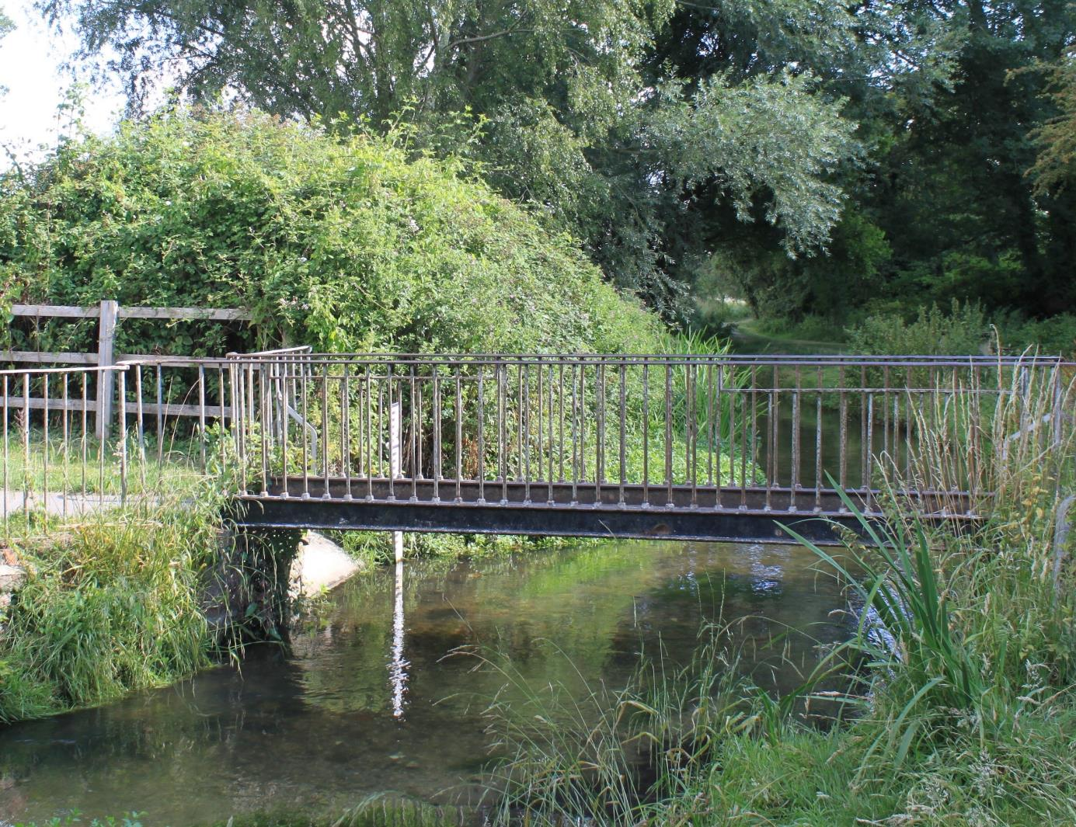

Slide 86
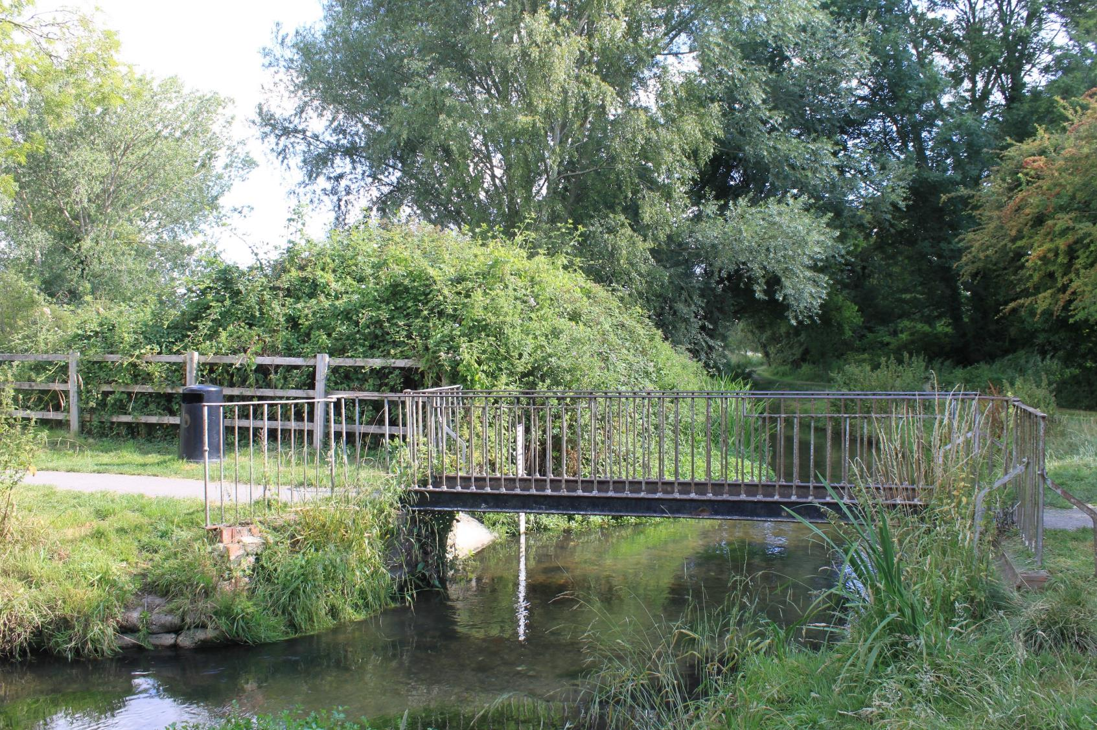

Slide 87
Hanney History Walk
Hanney History Group hopes that you have enjoyed your walk and learnt a little about our history.
We would appreciate any comments or corrections…. but, even more, we would welcome any photographs, cuttings or just memories from earlier times before they get lost for ever.
Hanney History Group : www.hanneyhistory.org.uk
Hanney History Group would like to thank Hanney News for their assistance in producing this pamphlet.

